Slide 1

Air Cargo Contamination
Trade Outreach

Slide 2
Objectives
Why are contaminants a concern?
Examples of air cargo contamination.
Ways to prevent it.

Slide 3
What is Pest Contamination?
  Visible forms of animals, insects or other invertebrates (alive or dead, in any lifecycle stage, including egg casings or rafts), or any organic material of animal origin (including blood, bones, hair, flesh, secretions, excretions); viable or non-viable plants or plant products (including fruit, seeds, leaves, twigs, roots, bark); or other organic material, including fungi; or soil, or water; where such products are not the manifested cargo within the Cargo Transport Unit (i.e., container).
- IMO/ILO/UNECE. (2014, January). Code of Practice for Packing of Cargo Transport Units (CTU Code).

Slide 4
Impact
Agriculture is the LARGEST industry and employment sector in the United States, with more than $1,000,000,000,000 (1 trillion) in economic activity annually.
The greatest risk to the success of this industry are exotic plant pests and foreign animal diseases.
Currently, invasive species cause an estimated $136,000,000,000 (136 billion) in lost agriculture revenue annually.

Slide 5

How Do Contaminants Affect You?
COSTLY
  Warehouse storage fees
  Cleaning
  Fumigation
  Re-export charges

Slide 6

How Do Contaminants Affect You?
TIME CONSUMING
  Delays
  Cancelled deliveries
  Loss of business

Slide 7
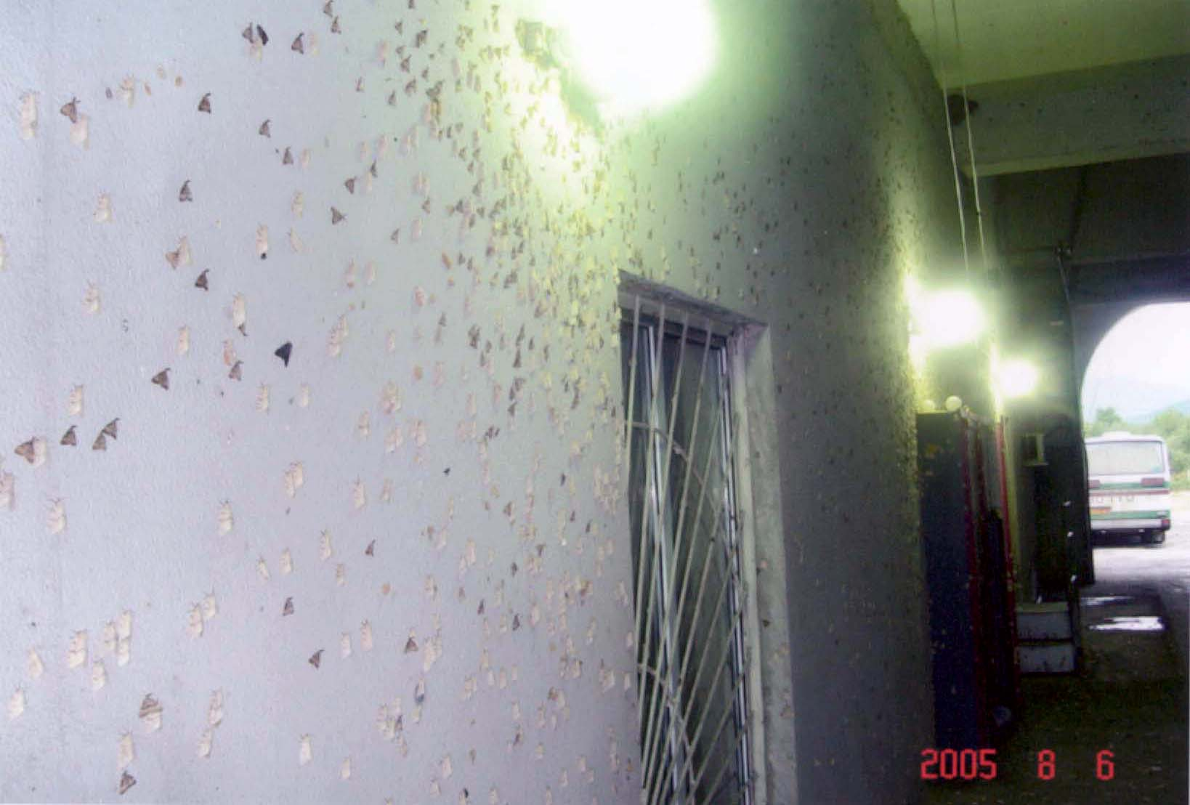
Bright Lights Attract Insects
Photo Credit: APTL Library

Slide 8
Loading Cargo at Night
  Bright lights will attract insects.
  Those insects will enter open cargo holds.
  Keep doors closed, especially at night, when cargo is not being loaded or unloaded.

Slide 9
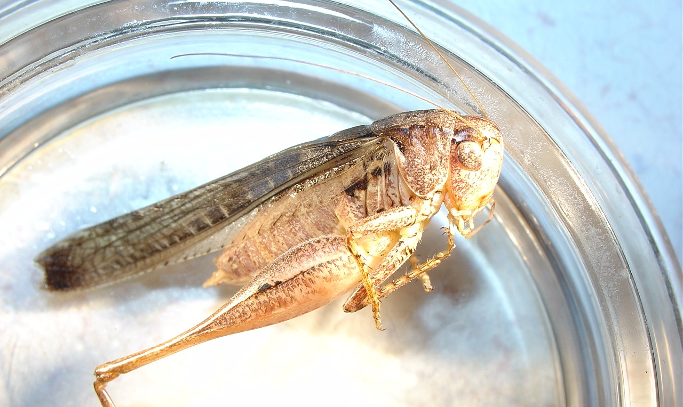
Common Hitchhiking Pest
Photo Credit: Port of Alexandria Bay
Notes:
Jumping, flying, crawling and stinging insects are found by CBP, hitch hiking a ride over with all types of cargo.

Slide 10
Pest Contaminants May Require Action
  If contaminants are found the following may be required:
  Cleaning of hold including “cans” and “cookie sheets”
  Fumigation
  Immediate Export
    To avoid these costs and delays…

Slide 11
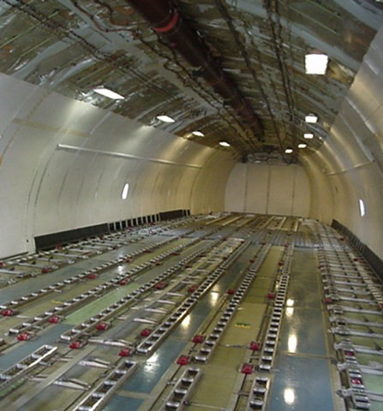
Ensure Cargo Holds Start Clean
Photo Credit: APTL Library

Slide 12
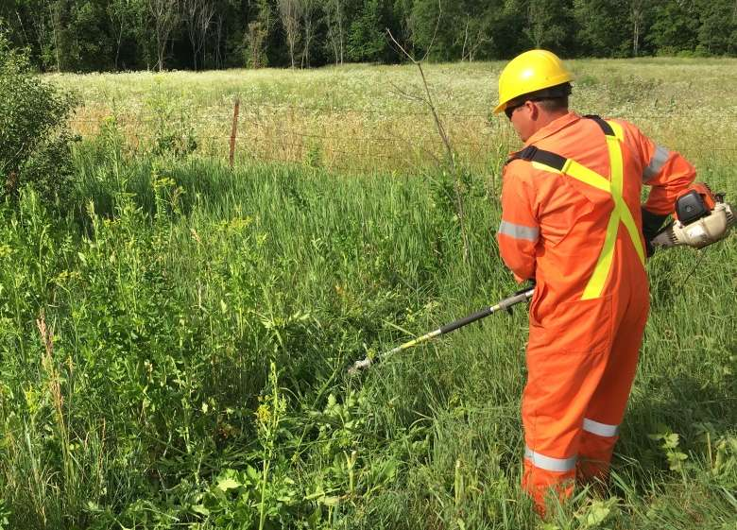
Keep Vegetation Near Facilities Mowed
Photo Credit:

Slide 13
Keep Your Cargo and Aircraft Clean
  Sweep, vacuum, or wash air freight containers, “cans” and cargo aircraft pallets, “cookie sheets” prior to loading.
  Keep vegetation around loading areas mowed.
  Avoid loading when insects are swarming.

Slide 14
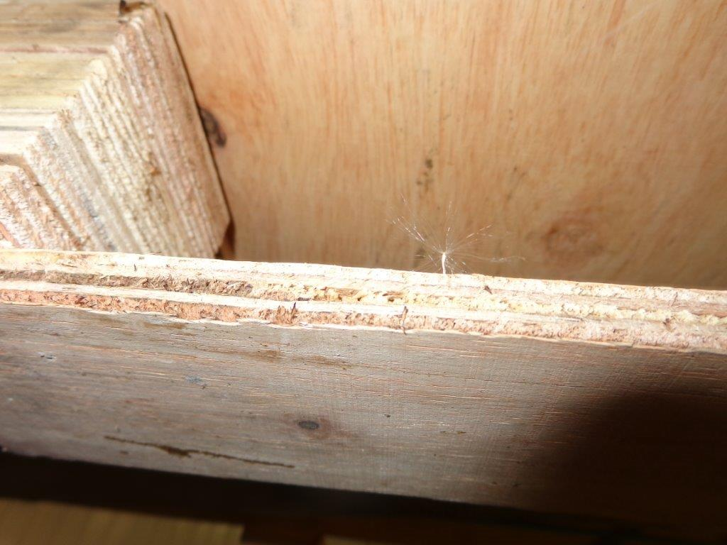
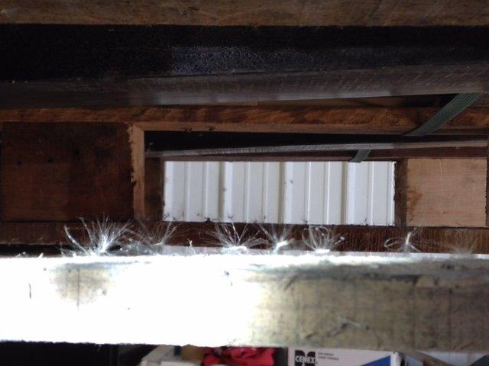
Weed Seeds Stuck to Wood Packaging
Photo Credit: Seattle Field Office

Slide 15
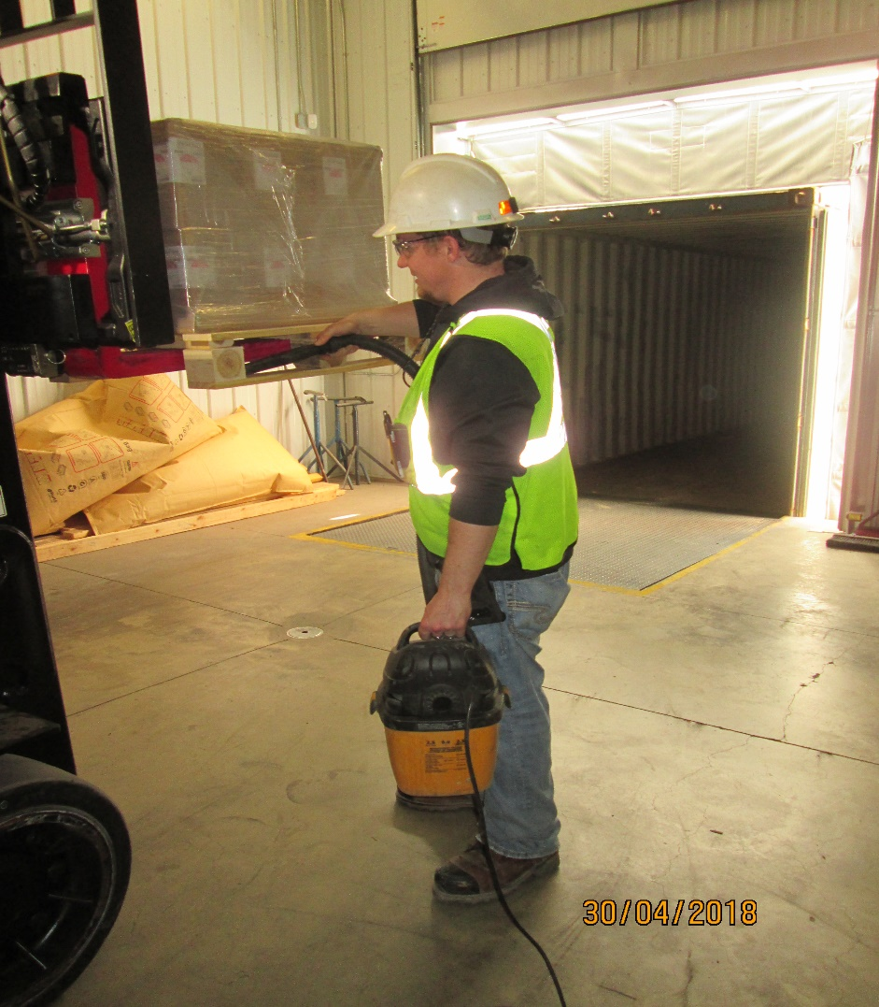
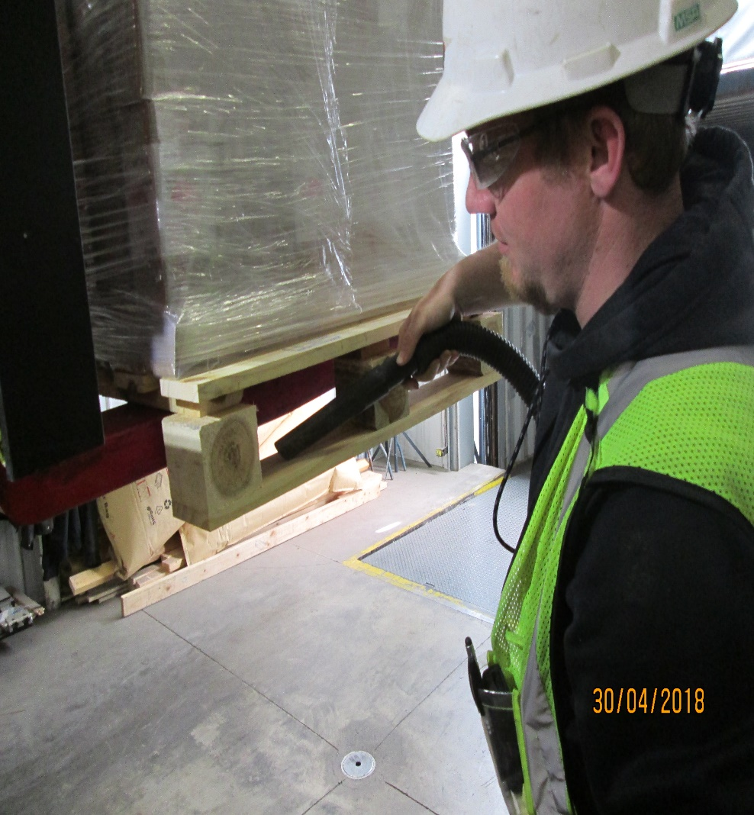
Vacuuming Weed Seeds from Wood Packing
Photo Credit: Port of International Falls

Slide 16
For More Information Contact:
Department of Homeland Security
U.S. Customs and Border Protection
Office of Field Operations
Agriculture Programs and Trade Liaison
APTL Program Manager - Safeguarding
Office: (202) 344-3298
Address: DHS, CBP, OFO, APTL
1300 Pennsylvania Ave., NW
Room 2.5B
Washington, D.C. 20229

