Slide 1

Seaport Pest Contamination
Trade Outreach

Slide 2
Objectives
Why is pest contamination at seaports a concern?
Examples of sea container pest contamination.
Ways to prevent it.

Slide 3
What is Pest Contamination?
  Visible forms of animals, insects or other invertebrates (alive or dead, in any lifecycle stage, including egg casings or rafts), or any organic material of animal origin (including blood, bones, hair, flesh, secretions, excretions); viable or non-viable plants or plant products (including fruit, seeds, leaves, twigs, roots, bark); or other organic material, including fungi; or soil, or water; where such products are not the manifested cargo within the Cargo Transport Unit (i.e., container).
- IMO/ILO/UNECE. (2014, January). Code of Practice for Packing of Cargo Transport Units (CTU Code).

Slide 4
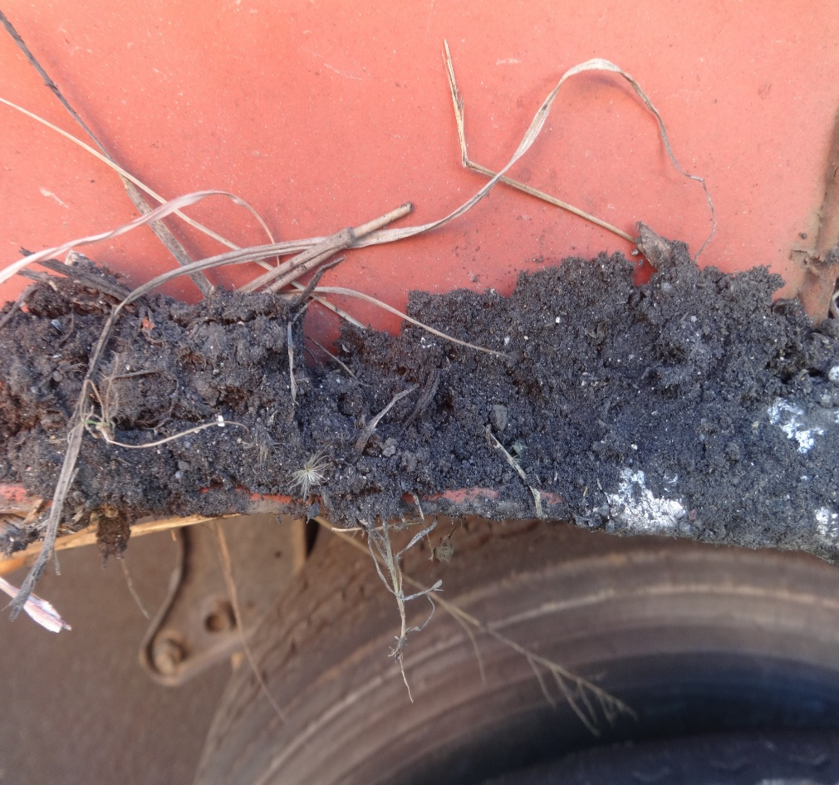
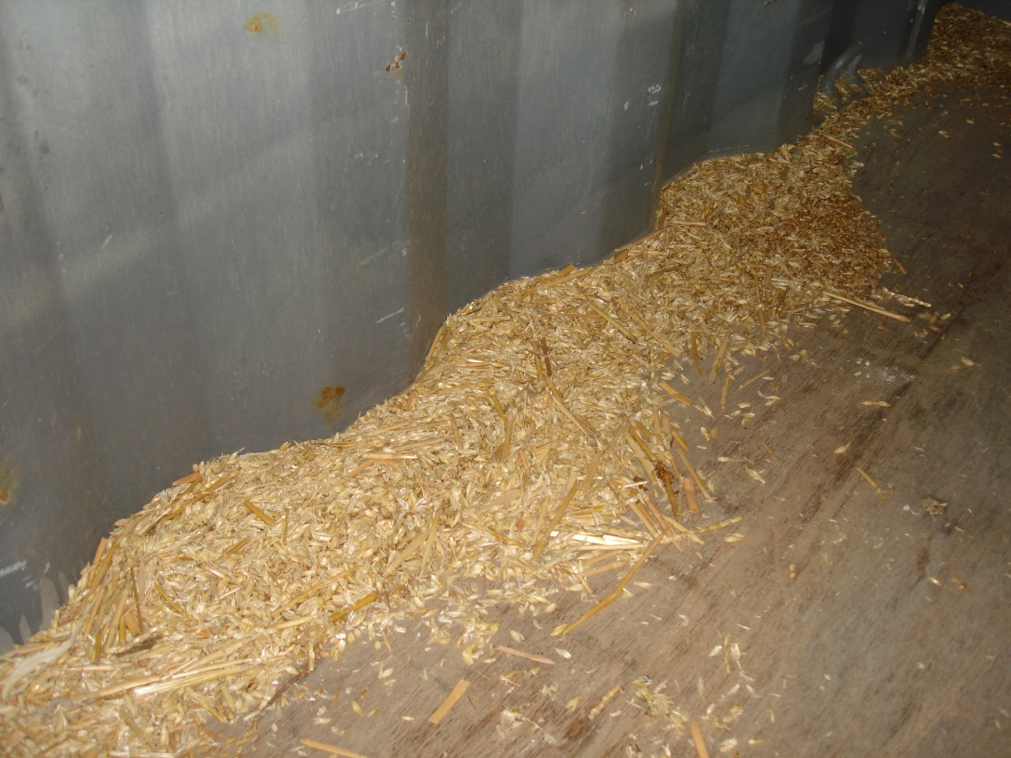
What is Sea Container Pest Contamination?
Photo Credit: San Francisco Field Office
Photo Credit: San Diego Field Office

Slide 5
Impact
Agriculture is the LARGEST industry and employment sector in the United States, with more than $1,000,000,000,000 (1 trillion) in economic activity annually.
The greatest risk to the success of this industry are exotic plant pests and foreign animal diseases.
Currently, invasive species cause an estimated $136,000,000,000 (136 billion) in lost agriculture revenue annually.

Slide 6

How Does Pest Contamination Affect You?
COSTLY
  Demurrage, drayage, devanning fees
  Fumigation
  Cleaning
  Possible re-export charges
Higher res clip art needed

Slide 7

How Does Pest Contamination Affect You?
TIME CONSUMING
  Delays
  Cancelled deliveries
  Loss of business
Higher Res clip art needed

Slide 8
How Do You Address the Risk?
  Store cargo away from vegetation.
  Avoid setting containers on grain, soil, or vegetation.
  Visually inspect cargo and containers for contaminants and pests before loading.
  Sweep, vacuum, or wash containers prior to loading.

Slide 9
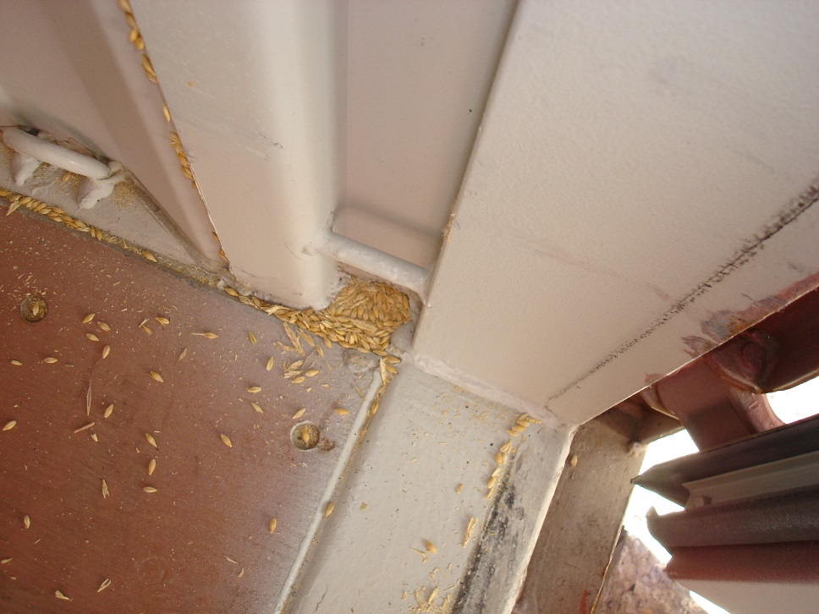
Spilled Seed on Container Floor
Photo Credit: Baltimore Field Office

Slide 10
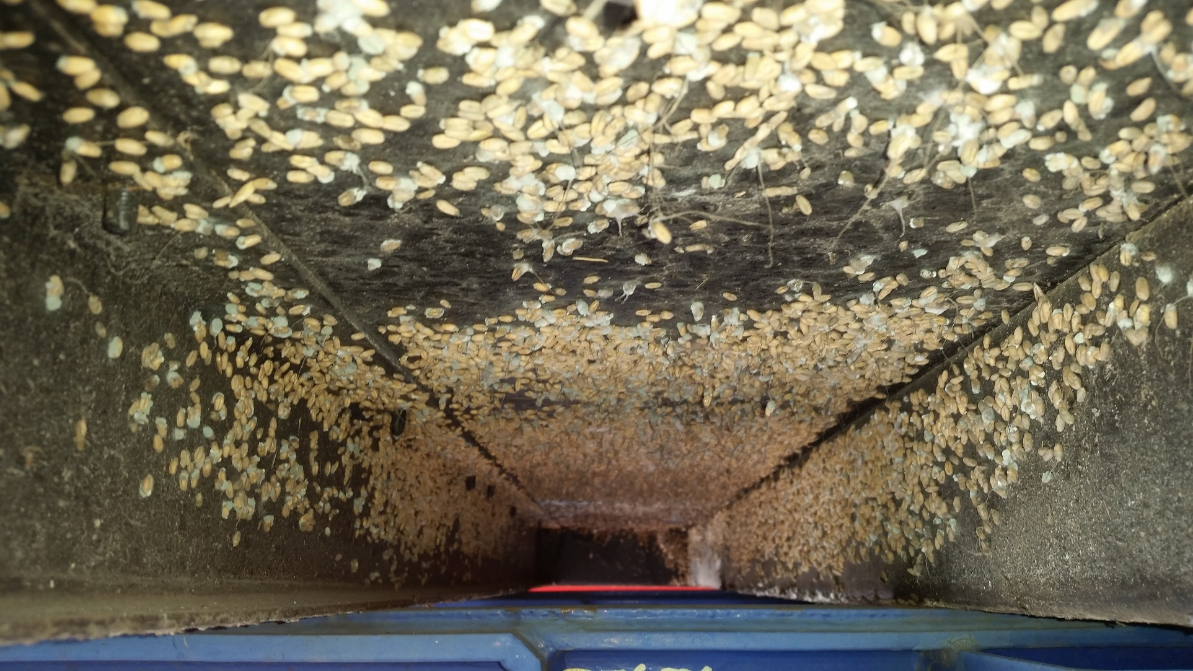
Seeds - Container Undercarriage
Photo Credit: Port of Charleston

Slide 11
Why are Seed Contaminants a Risk?
  They can carry plant pathogens.
  May harbor plant pests.
  Many foreign weed seeds are considered Federal Noxious Weeds in the United States.
  What you can do about it…

Slide 12
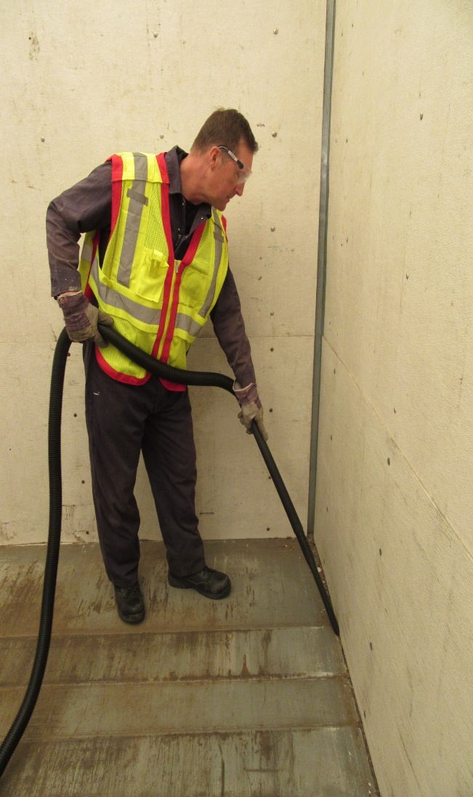
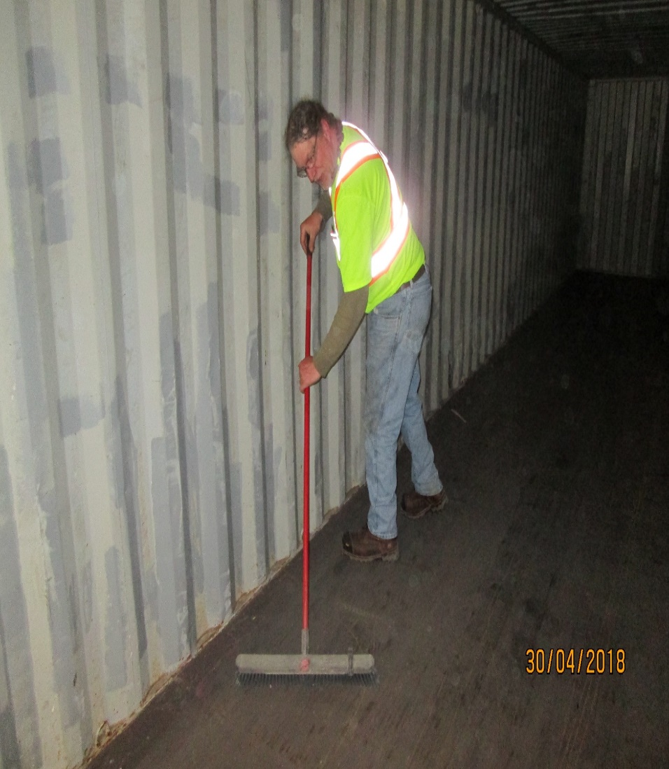
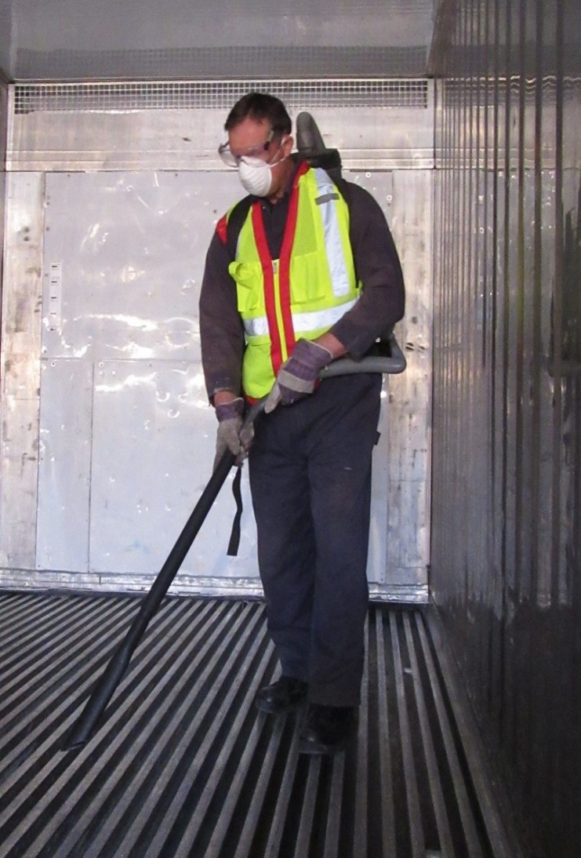
Vacuum, Sweep or Blow Out Containers
Photo Credit: Ports of Buffalo and International Falls

Slide 13
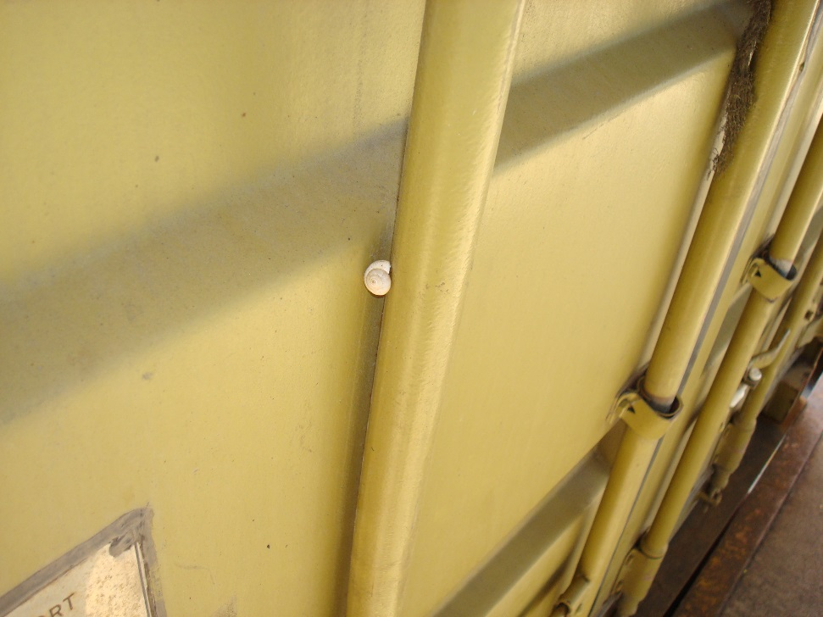
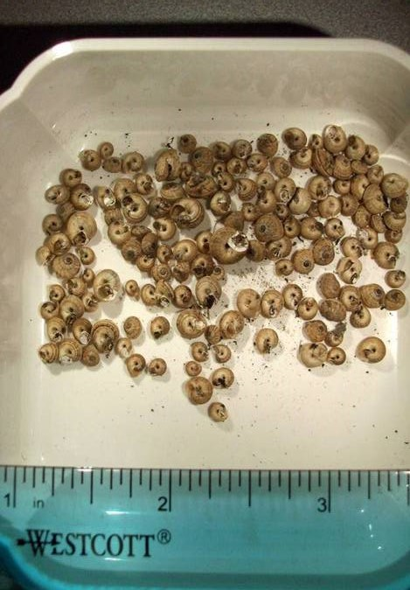
Snails
Photo Credit: Baltimore Field Office
Photo Credit: Seattle Field Office

Slide 14
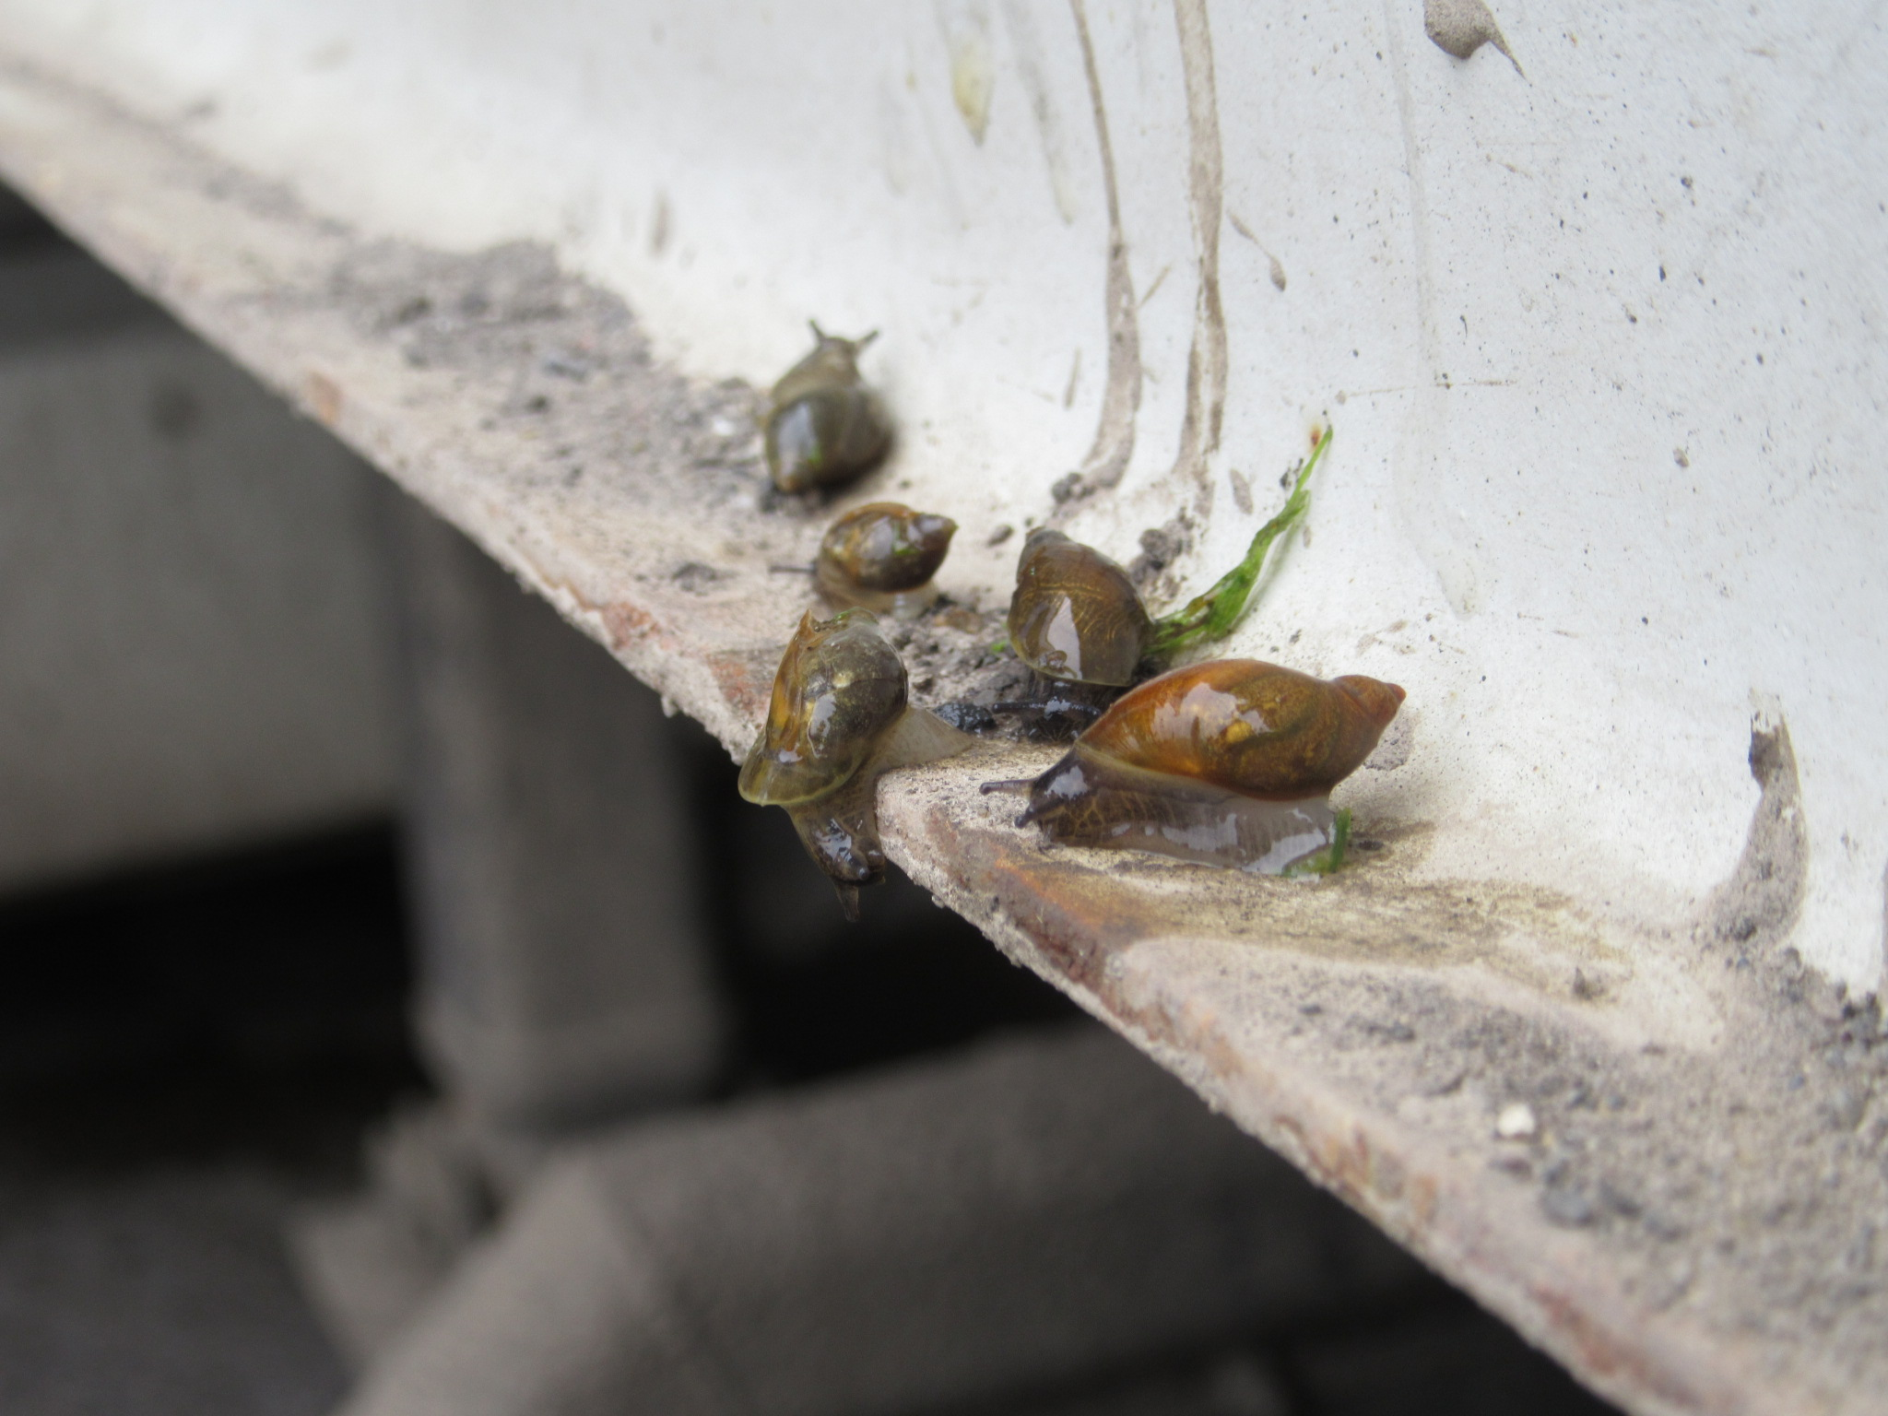
Snails
Photo Credit: Port of Buffalo

Slide 15
Why are Snails a Risk?
  Many snails are destructive agricultural pests, and are very difficult to eradicate if they become established.
  Snails typically found on containers are quite small – often less than an inch in diameter.
  Vectors for both human and animal diseases.

Slide 16
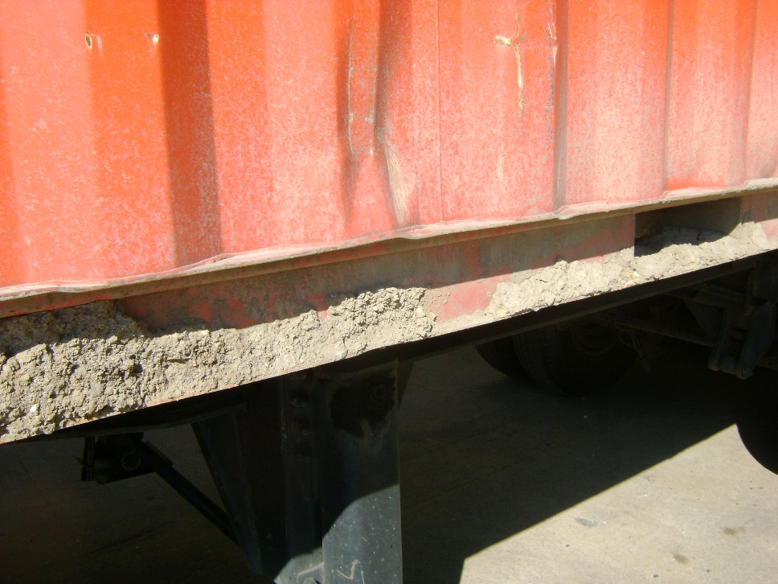
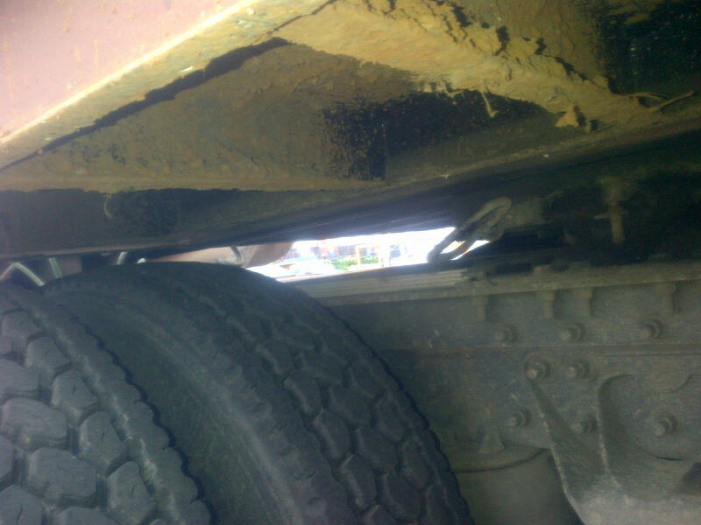
Soil - Container Undercarriage
Photo Credit: Baltimore Field Office

Slide 17
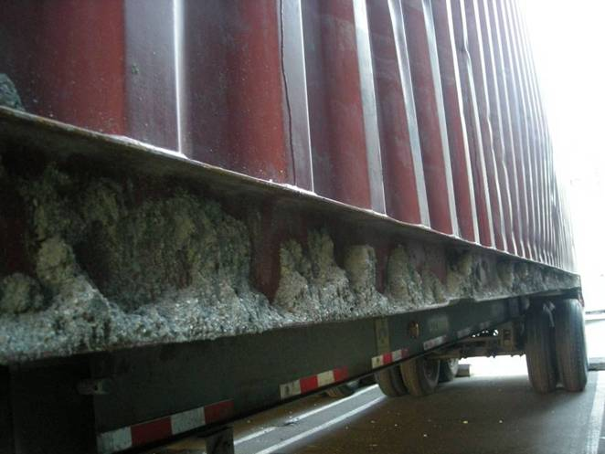
Soil attached to Exterior of Container
Photo Credit: Seattle Field Office

Slide 18
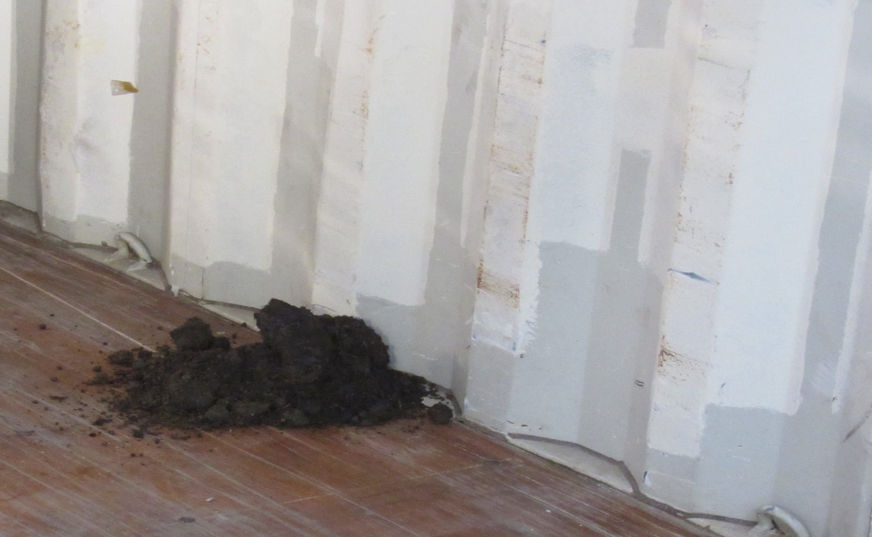
Soil Inside Intermodal Container
Photo Credit: San Francisco Field Office

Slide 19
Why is Soil Contamination a Risk?
  Soil can harbor insect pests and weed seeds.
  Nematodes (microscopic worms) may be present in soil. They can be very harmful to plants, and can be exceedingly difficult to eradicate.
  Soil also is a vector for foreign animal diseases.
  What you can do about snails and soil….

Slide 20
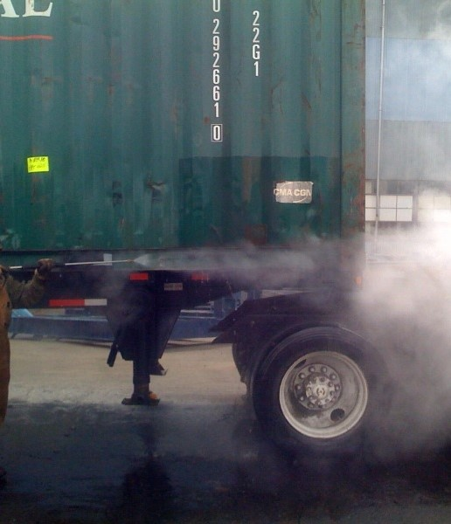
Spray Off Contaminated Containers
Photo Credit: Seattle

Slide 21
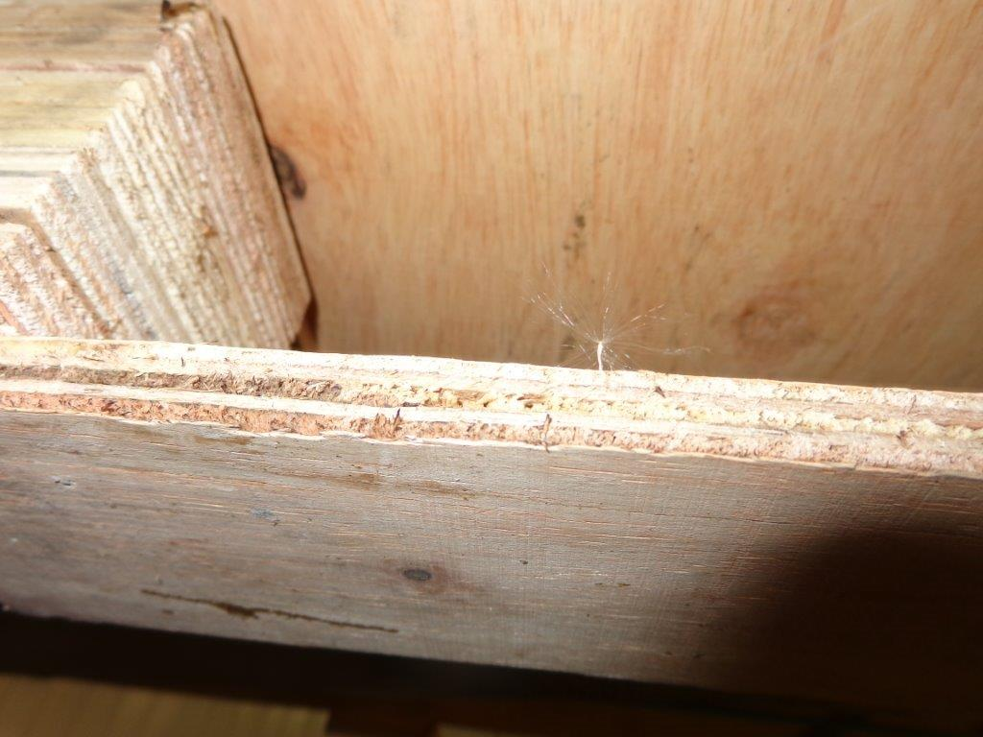
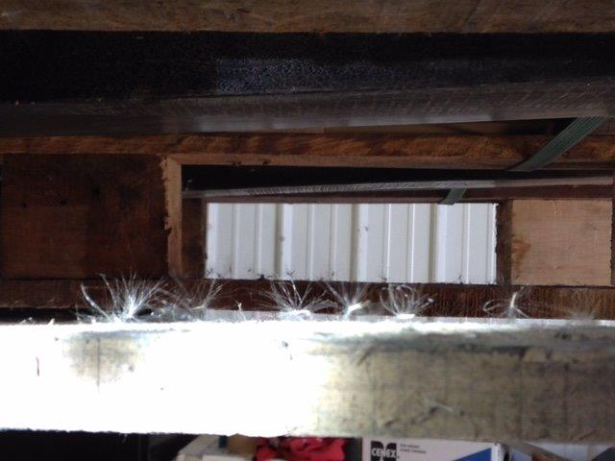
Weed Seeds Stuck to Wood Packaging
Photo Credit: Seattle Field Office

Slide 22
Why are Seeds with Wood Packaging a Risk?
  Not all seeds can be found on container floors.
  Some seeds blow around easily and attach to wood pallets and crates.
  What can you do about seeds on wood packaging….

Slide 23
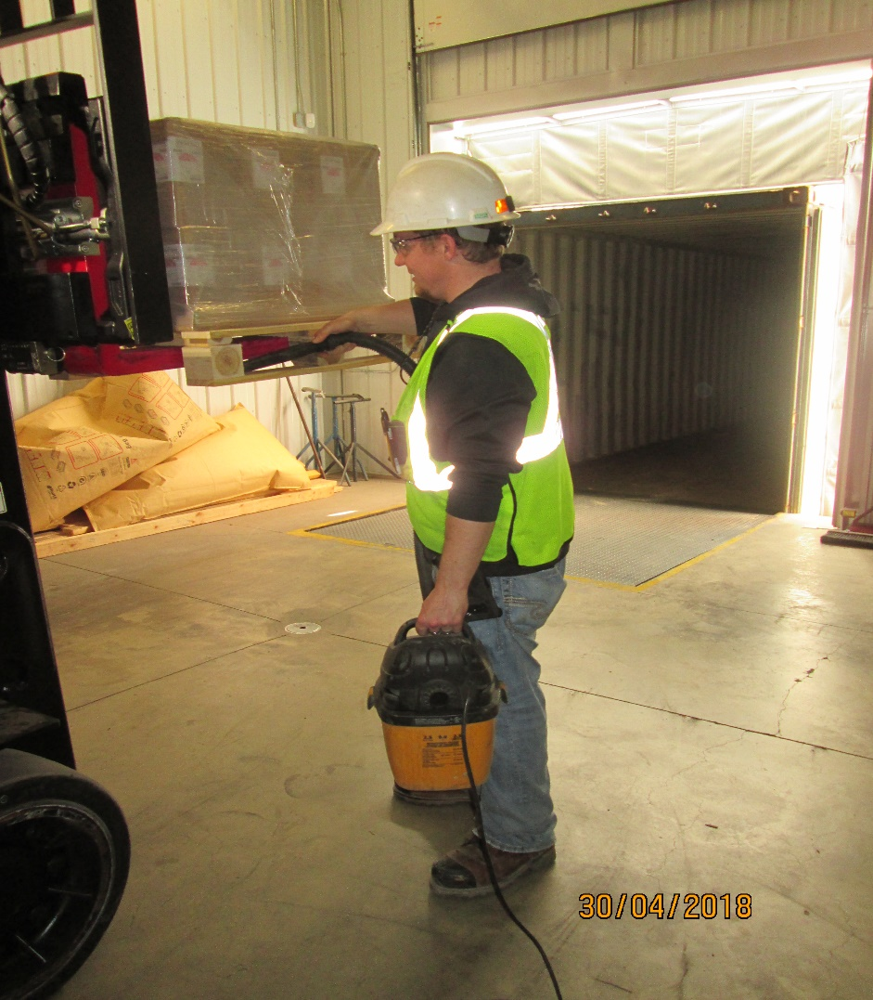
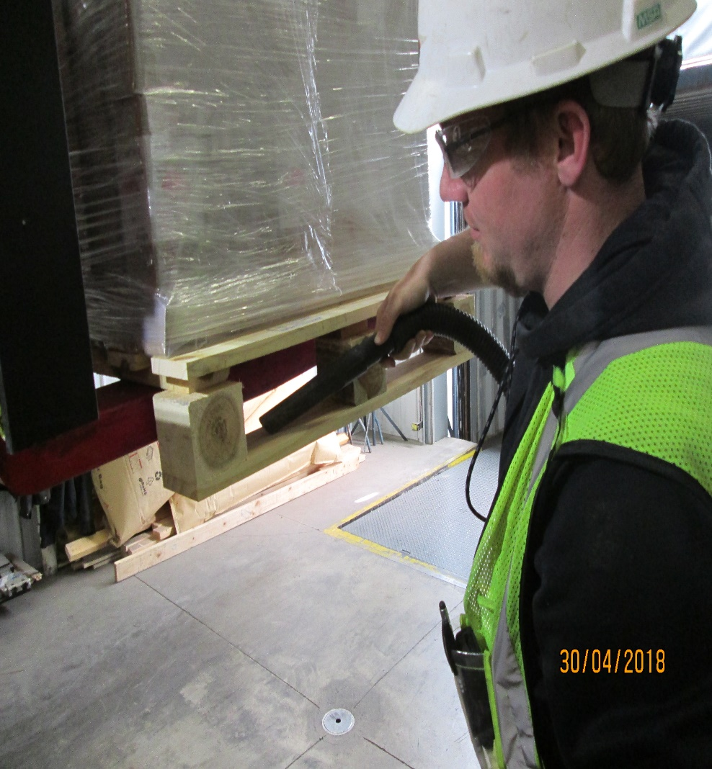
Vacuuming Weed Seeds from Wood Packaging
Photo Credit: Port of International Falls

Slide 24
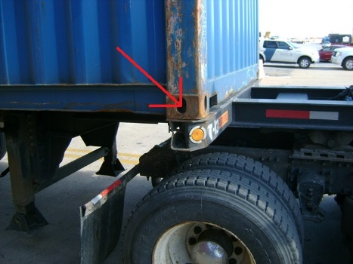
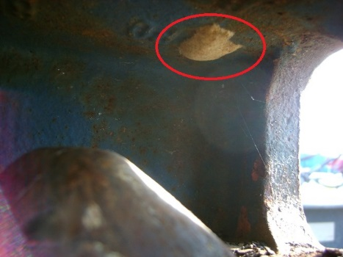
Insect Eggs
Photo Credit: Baltimore Field Office

Slide 25
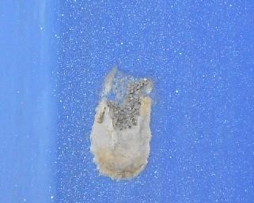
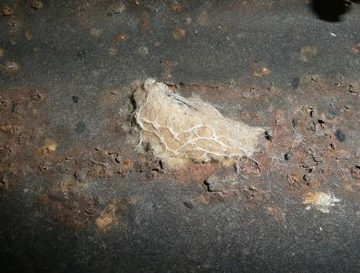
Insect Eggs
Photo Credit: Port of Oakland

Slide 26
Avoid Shipment Refusals
  Scrape and remove all insect egg masses from cargo and containers before shipping.
  Another option for removing insect eggs…

Slide 27
Steam Cleaning/Pressure Washing Container Exterior and Undercarriage
Photo Credit: Seattle

Slide 28
Conclusion
  Store containers away from natural areas and/or reduce vegetation around cargo and container storage areas.
  Inspect cargo and container (interior and exterior) prior to loading.
  Store, cover, and clean pallets, dunnage, crates, etc. as needed.

Slide 29
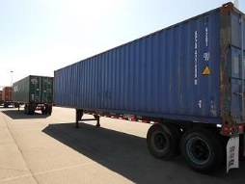
Where Possible - Utilize Paved Lots to Avoid Contamination

Slide 30
For More Information Contact:
Department of Homeland Security
U.S. Customs and Border Protection
Office of Field Operations
Agriculture Programs and Trade Liaison
APTL Program Manager
Office: (202) 344-3298
Address: DHS, CBP, OFO, APTL
1300 Pennsylvania Ave., NW
Room 2.5B
Washington, D.C. 20229

