Slide 1

Northern Border Truck Pest Contamination
Trade Outreach

Slide 2
Objectives
Why is pest contamination a concern?
Examples of truck trailer pest contamination.
Ways to prevent it.

Slide 3
What is Pest Contamination?
  Visible forms of animals, insects or other invertebrates (alive or dead, in any lifecycle stage, including egg casings or rafts), or any organic material of animal origin (including blood, bones, hair, flesh, secretions, excretions); viable or non-viable plants or plant products (including fruit, seeds, leaves, twigs, roots, bark); or other organic material, including fungi; or soil, or water; where such products are not the manifested cargo within the Cargo Transport Unit (i.e., container).
- IMO/ILO/UNECE. (2014, January). Code of Practice for Packing of Cargo Transport Units (CTU Code).

Slide 4
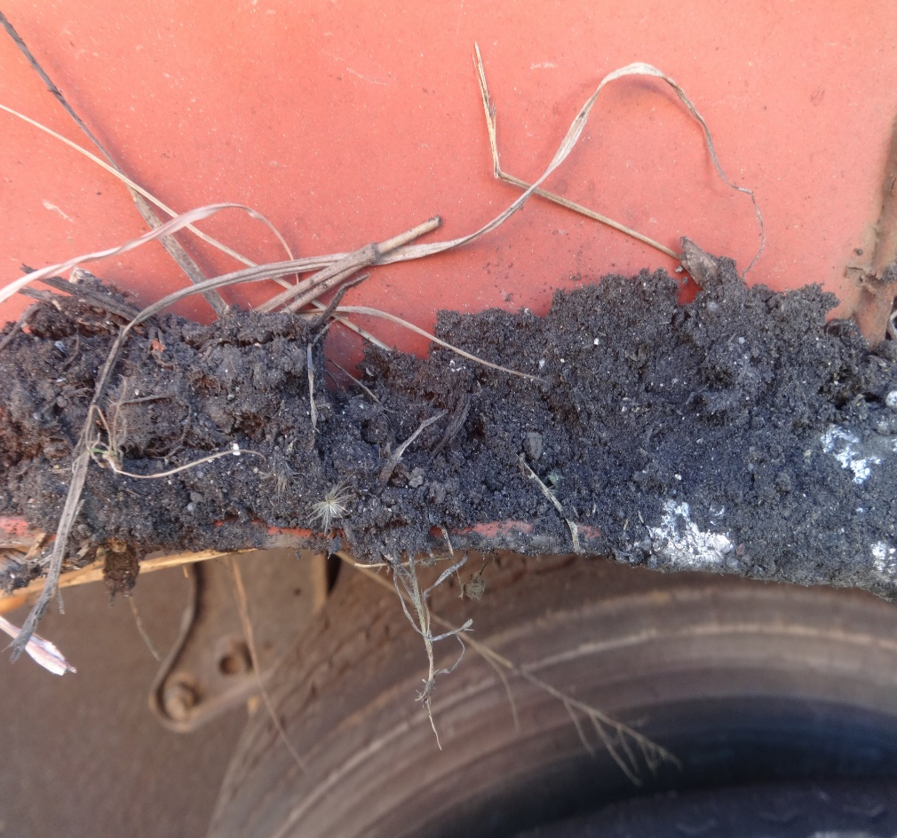
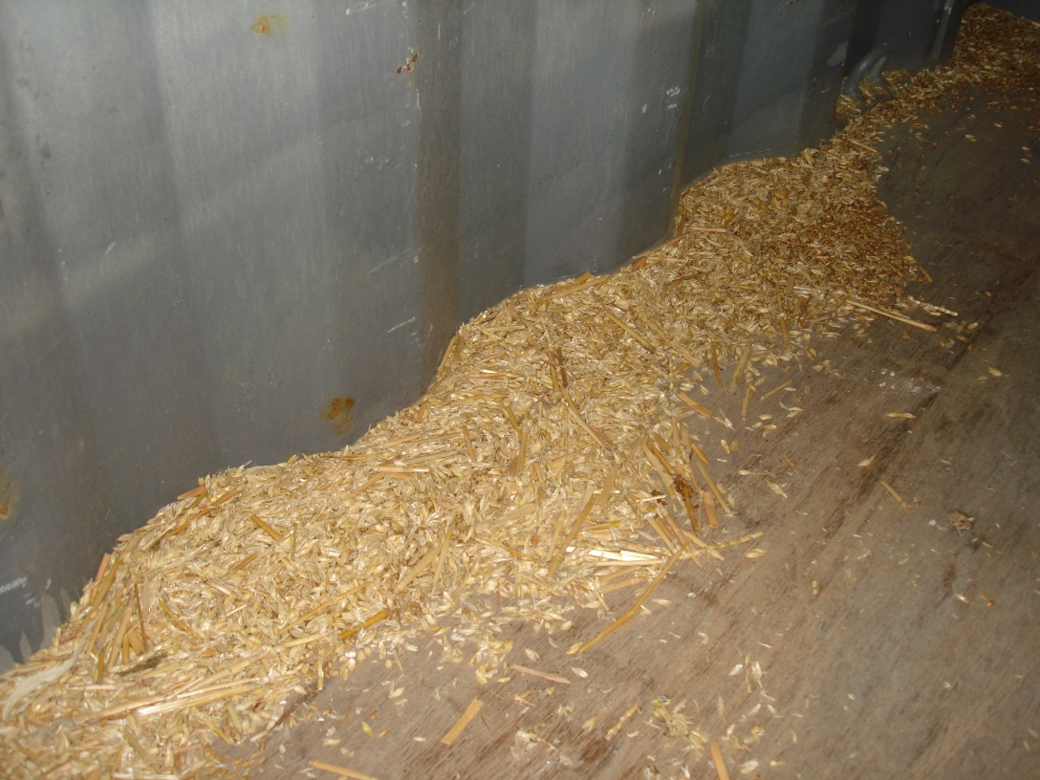
What is Truck Trailer Pest Contamination?
Photo Credit: San Francisco Field Office
Photo Credit: San Diego Field Office

Slide 5
Impact
Agriculture is the LARGEST industry and employment sector in the United States, with more than $1,000,000,000,000 (1 trillion) in economic activity annually.
The greatest risk to the success of this industry are exotic plant pests and foreign animal diseases.
Currently, invasive species cause an estimated $136,000,000,000 (136 billion) in lost agriculture revenue annually.

Slide 6

How Do Pest Contaminants Affect You?
COSTLY
  Devanning charges
  Cleaning
  Fumigation
  Possible re-export charges
Different, more high res clip art needed

Slide 7

How Do Pest Contaminants Affect You?
TIME CONSUMING
  Delays
  Cancelled deliveries
  Loss of business
Different, more high res clip art needed

Slide 8
How Do You Address the Risk?
  Store cargo away from vegetation.
  Avoid placing trailers over grain, soil, or vegetation.
  Visually inspect cargo and trailer for contaminants and pests before loading.
  Sweep, vacuum, or wash trailers prior to loading.

Slide 9
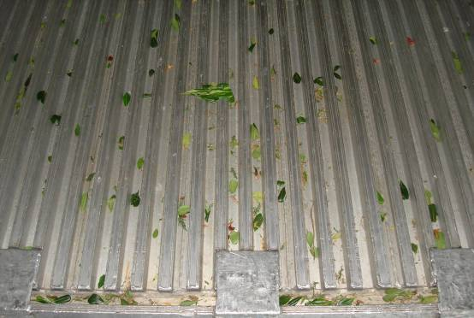
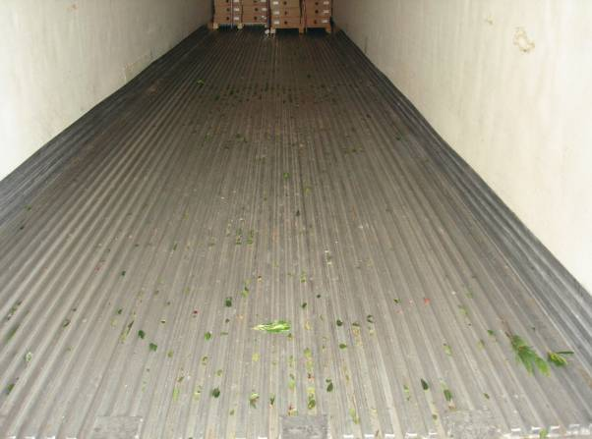
Plant Stems and Leaves on Trailer Floor
Photo Credit: Port of Otay Mesa
Photo Credit: Port of Otay Mesa

Slide 10
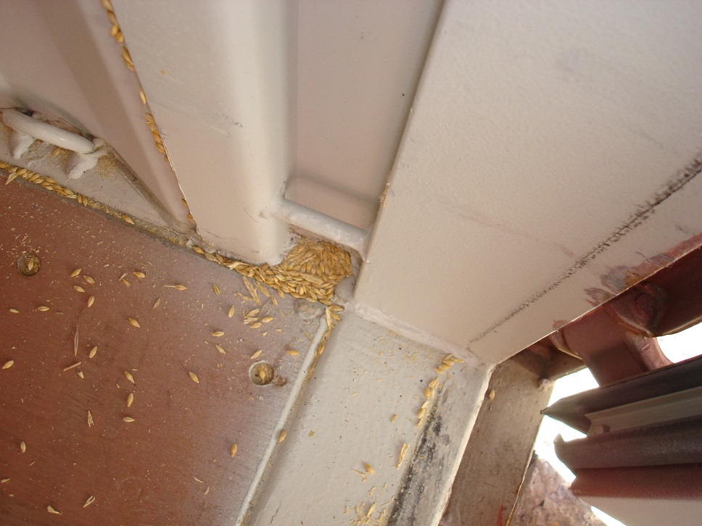
Spilled Seed on Trailer Floor
Photo Credit: Baltimore Field Office

Slide 11
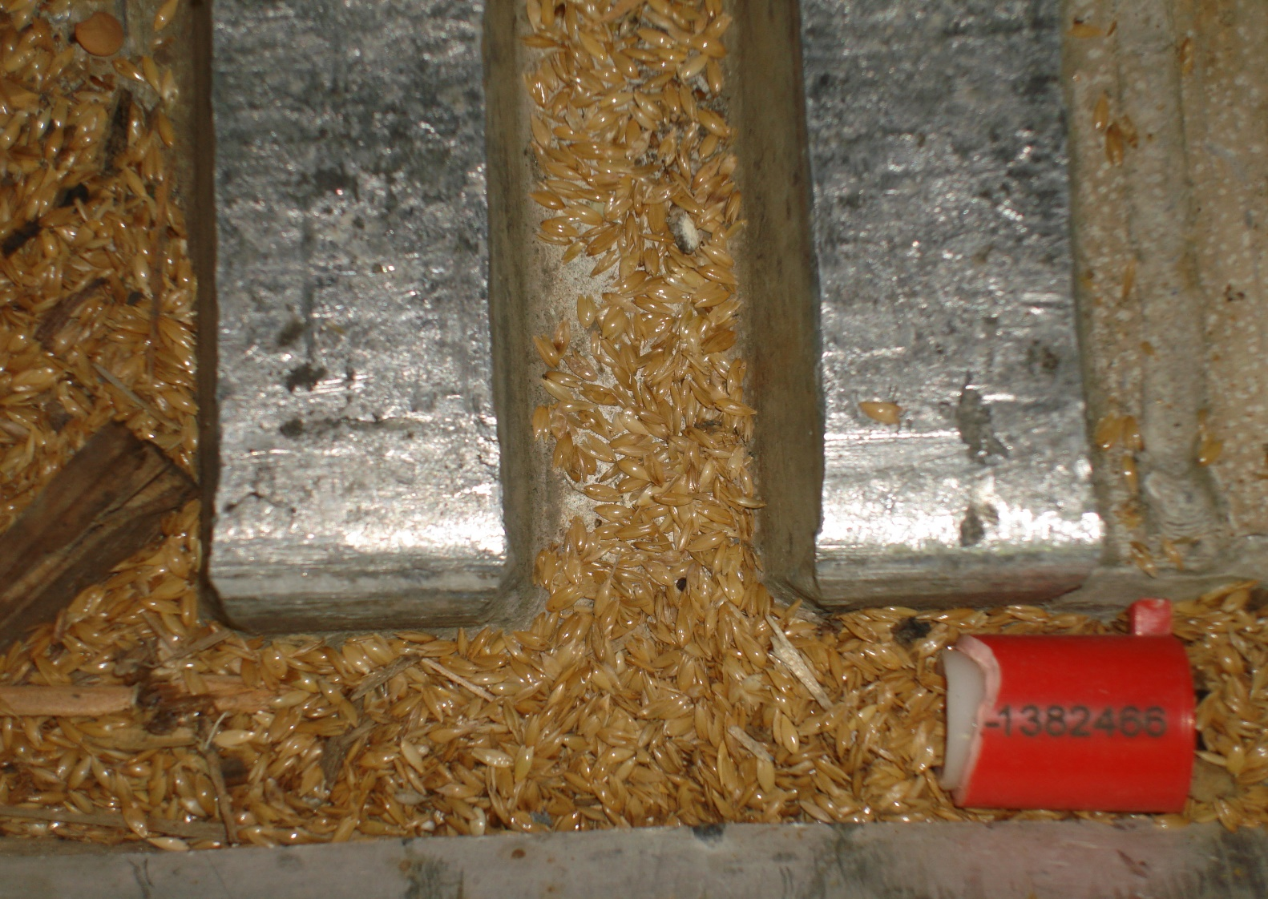
Spilled Seed on Trailer Floor
Photo Credit: San Diego Field Office

Slide 12
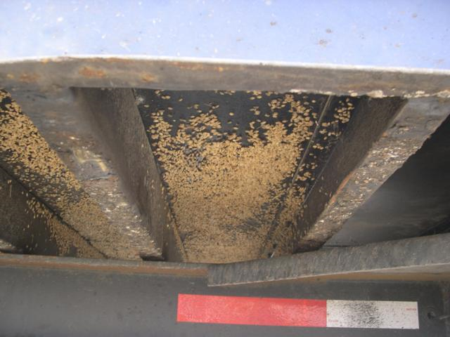
Seeds – Intermodal Container Undercarriage
APTL Photo Library

Slide 13
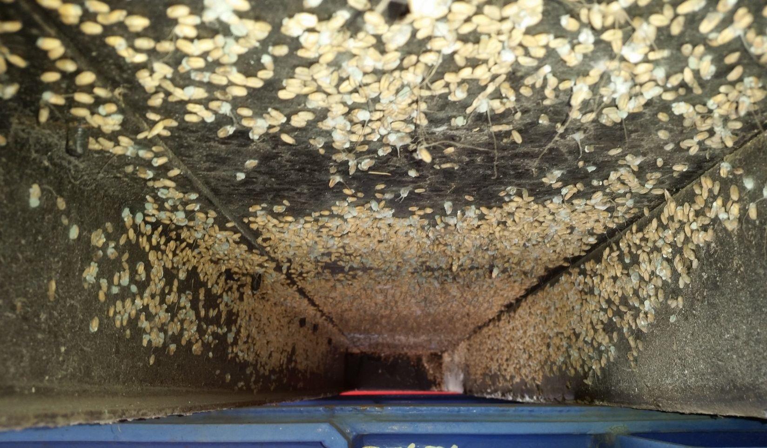
Seeds – Intermodal Container Undercarriage
Photo Credit: Port of Charleston

Slide 14
Why are Plant Material and Seed Contaminants a Risk?
  They can carry plant pathogens.
  Harbor plant pests.
  Many foreign weed seeds are considered Federal Noxious Weeds in the United States.
  What you can do about it…

Slide 15
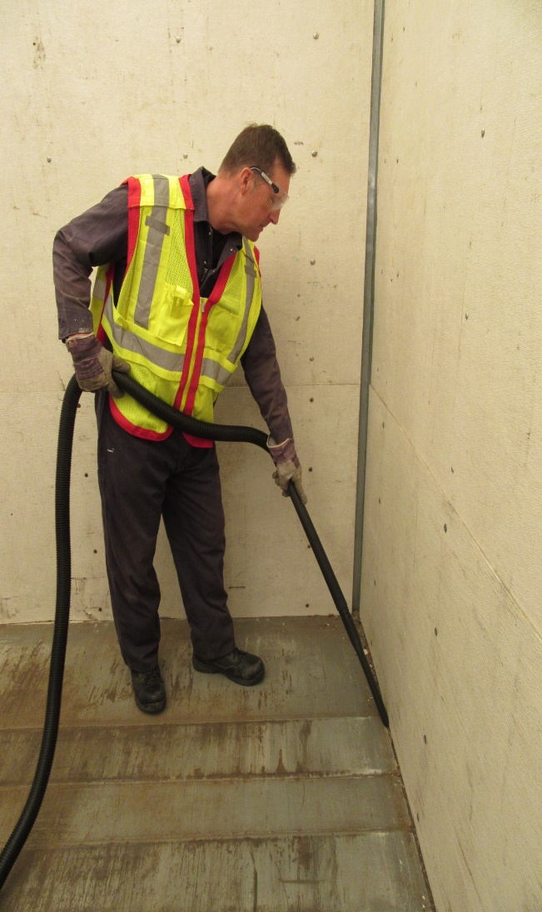
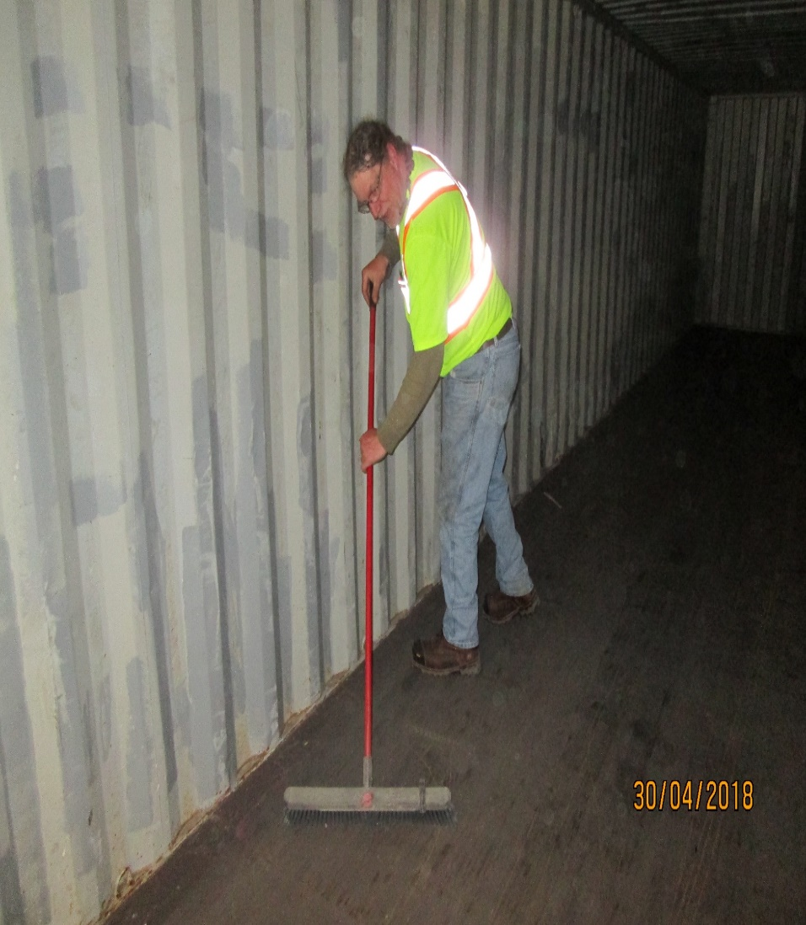
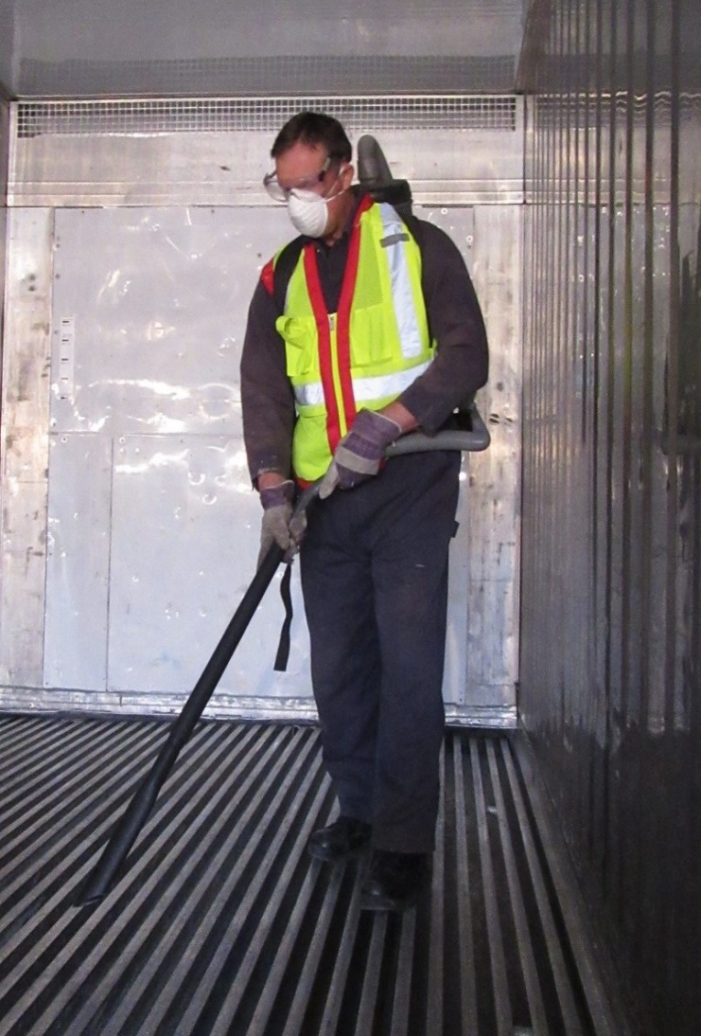
Blow, Sweep or Vacuum Out Trailers
Photo Credit: Ports of Buffalo and International Falls

Slide 16
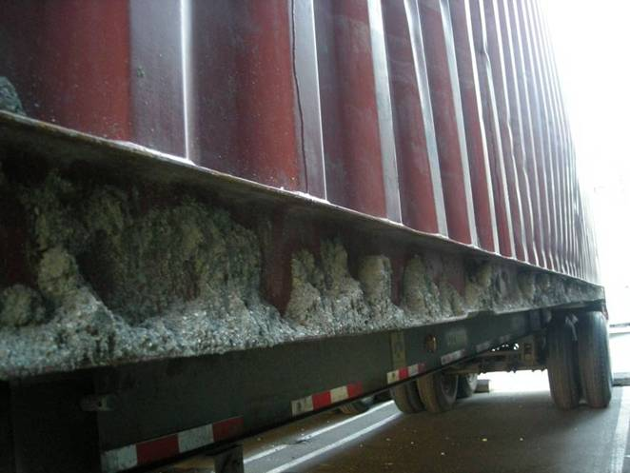
Soil Attached to Exterior of Container
Photo Credit: Seattle Field Office

Slide 17
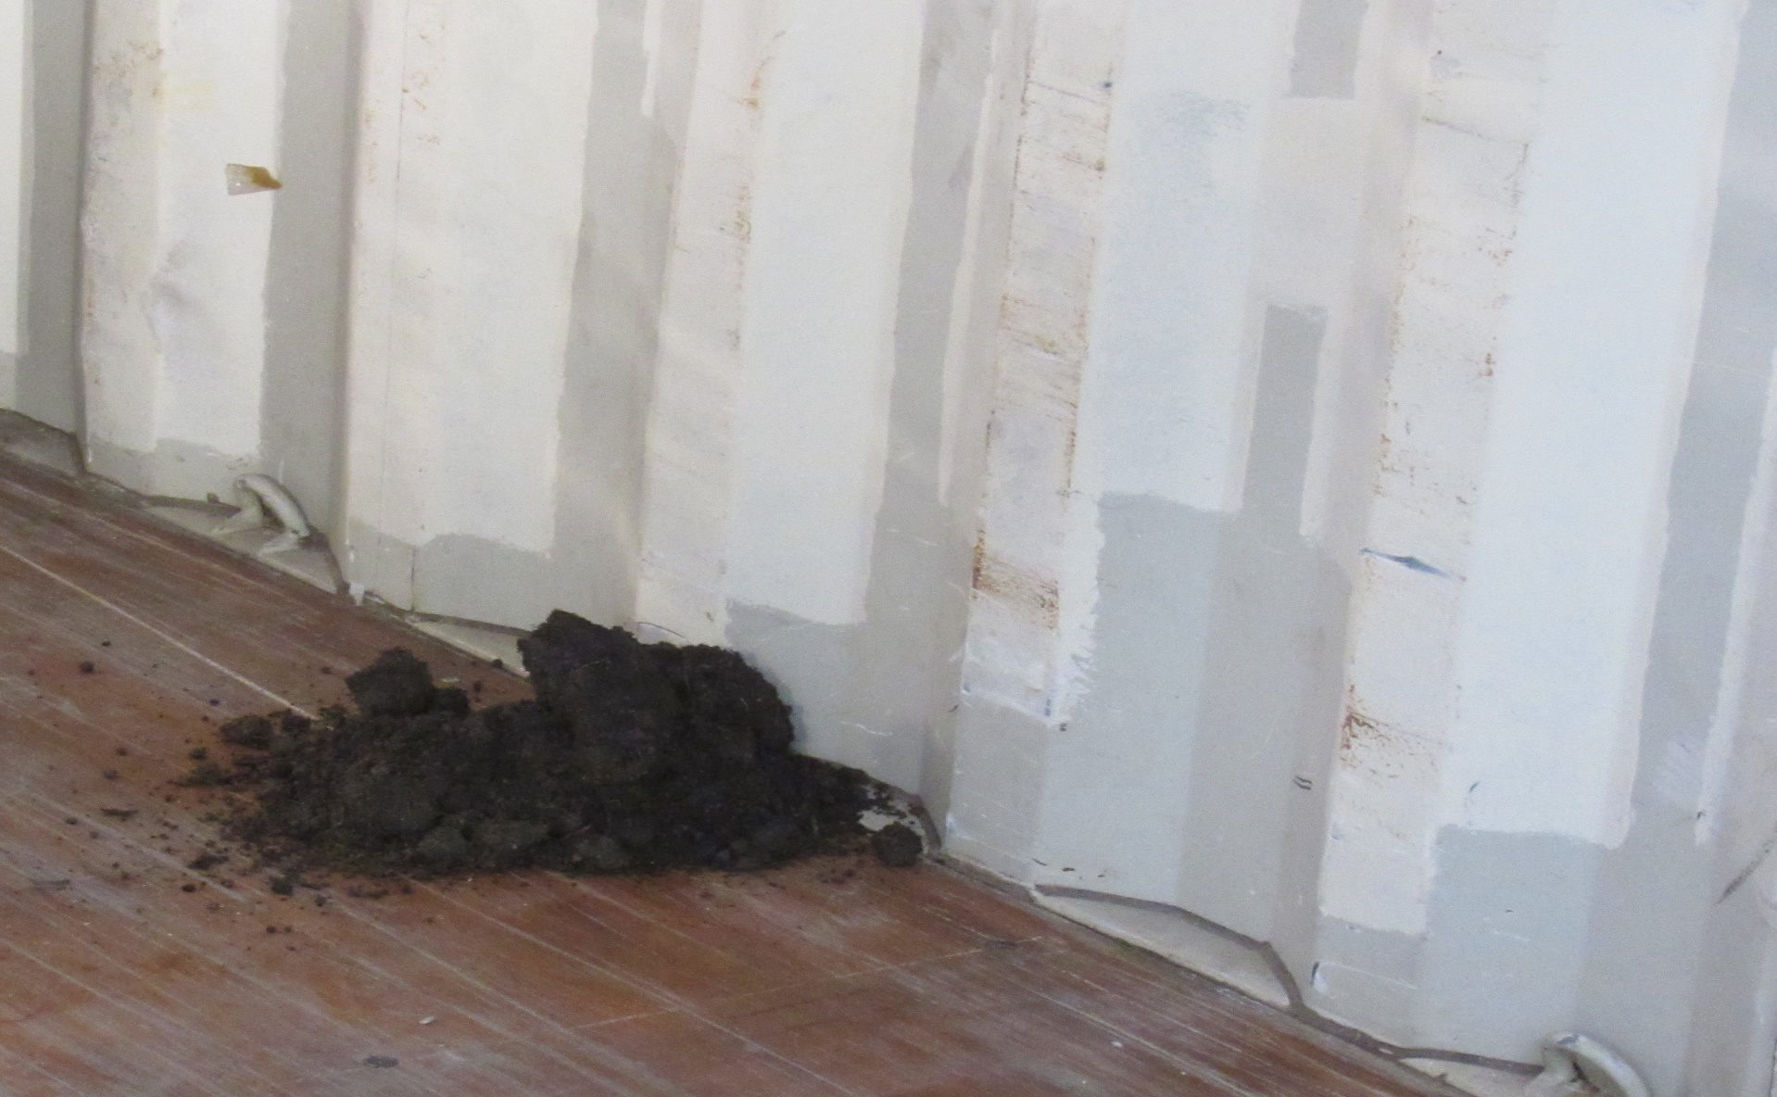
Soil Inside Intermodal Container
Photo Credit: Port of Buffalo

Slide 18
Why is Soil Contamination a Risk?
  Soil can harbor insect pests and weed seeds.
  Nematodes (microscopic worms) may be present in soil. These can be very harmful to plants, and are exceedingly difficult to eradicate.
  Soil also is a vector for foreign animal diseases.
  What you can do about snails and soil….

Slide 19
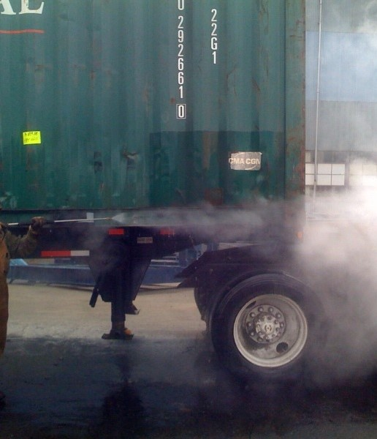
Clean Exterior of Trailer
Photo Credit: Seattle Field office

Slide 20
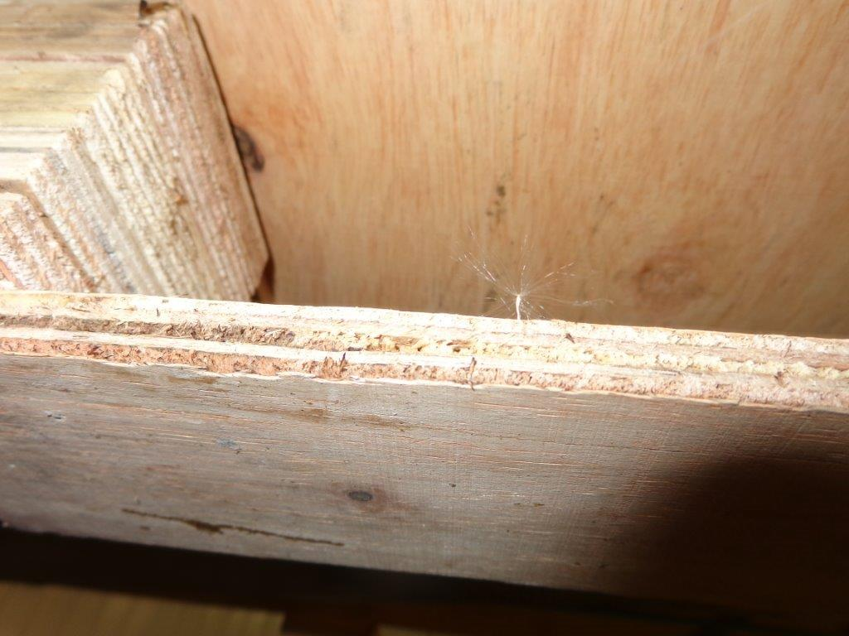
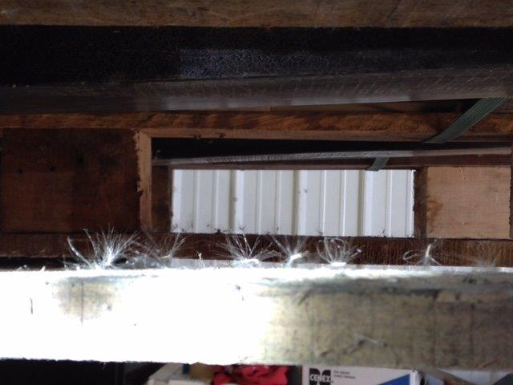
Weed Seeds Stuck to Wood Packaging
Photo Credit: Seattle Field Office

Slide 21
Why are Seeds with Wood Packaging a Risk?
  Not all seeds can be found on container floors.
  Some seeds blow around easily and attach to wood pallets and crates.
  What you can do about seeds on wood packaging….

Slide 22
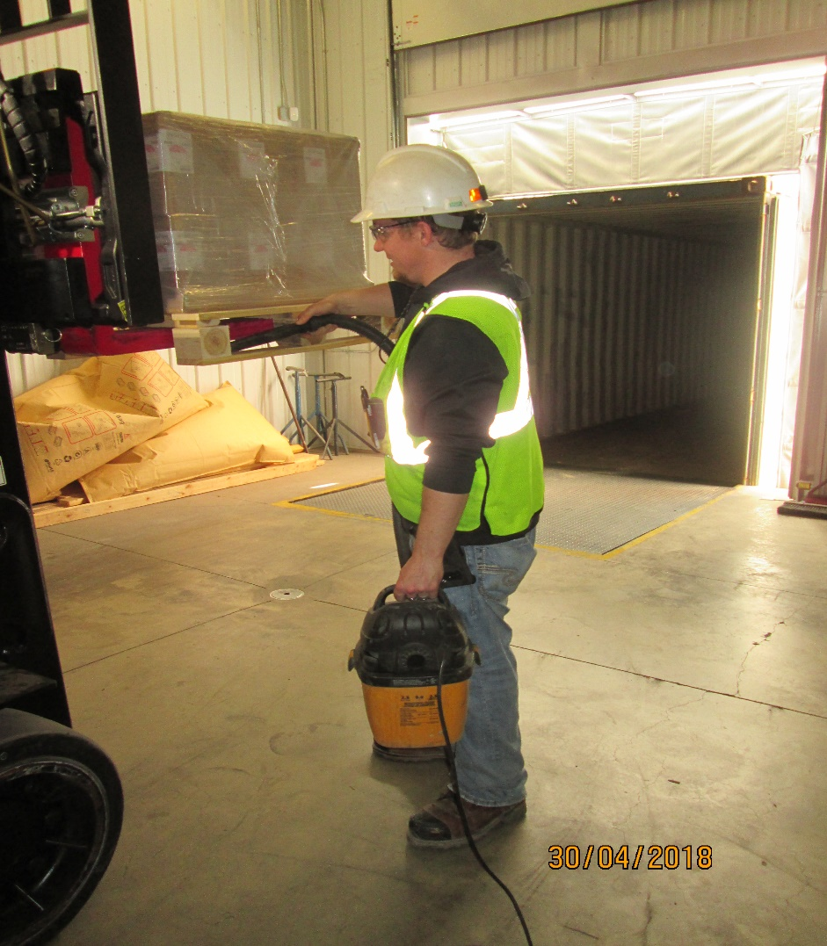
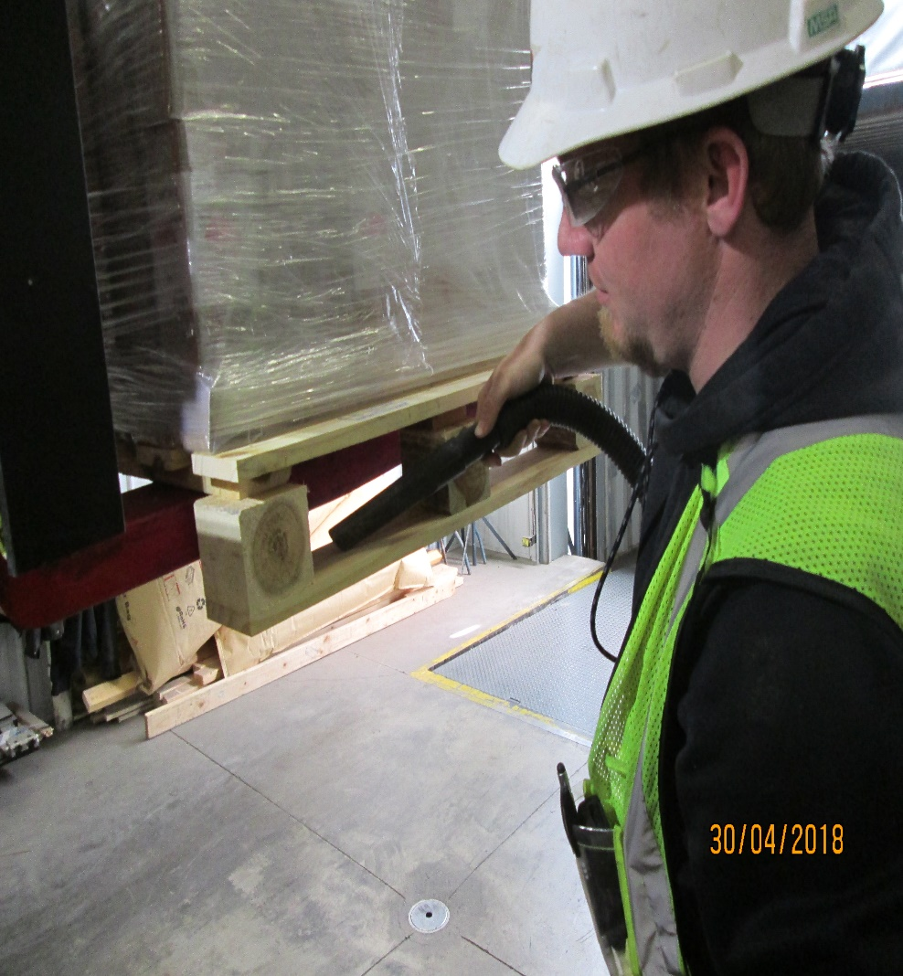
Vacuuming Weed Seeds from Wood Packaging
Photo Credit: Port of International Falls

Slide 23
Conclusion
  Store trailers away from natural areas and/or reduce vegetation around cargo and trailer storage areas.
  Inspect cargo and trailers (interior and exterior) prior to loading.
  Store, cover, and clean pallets, dunnage, crates, etc. as needed.

Slide 24
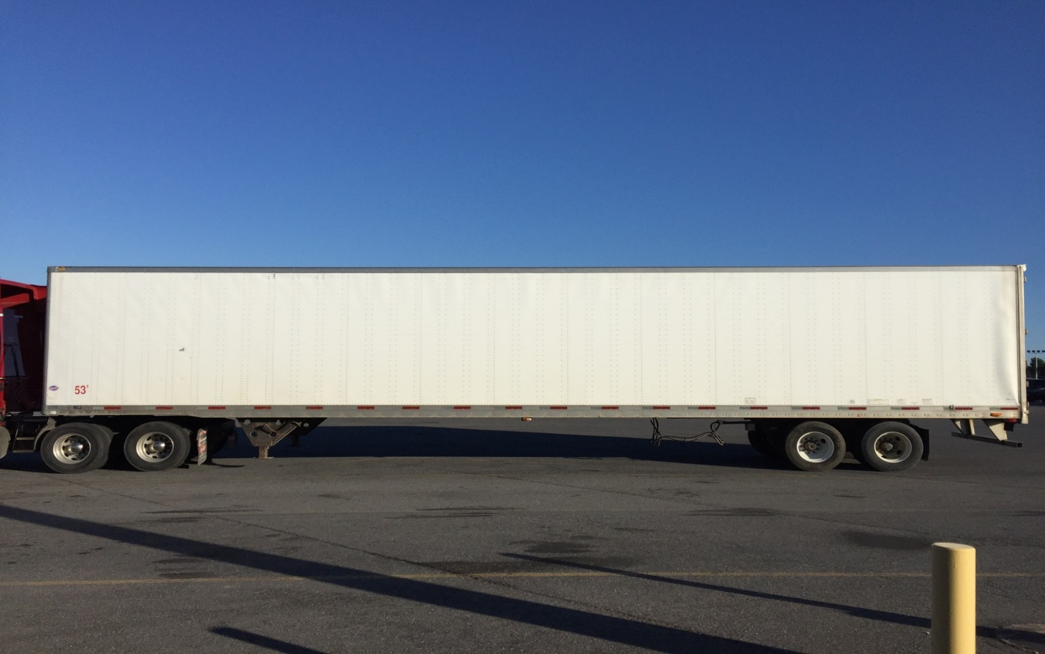
Where Possible - Utilize Paved Lots to Avoid Contamination
Photo Credit: Port of Champlain

Slide 25
For More Information Contact:
Department of Homeland Security
U.S. Customs and Border Protection
Office of Field Operations
Agriculture Programs and Trade Liaison
APTL Program Manager
Office: (202) 344-3298
Address: DHS, CBP, OFO, APTL
1300 Pennsylvania Ave., NW
Room 2.5B
Washington, D.C. 20229

