Slide 1
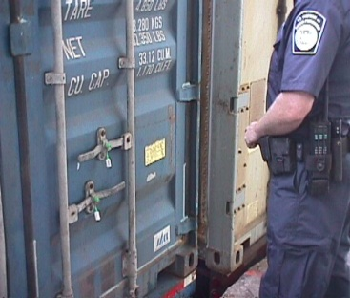
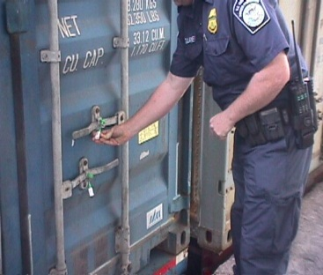
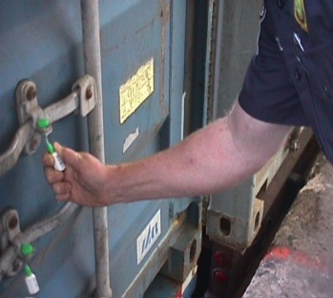
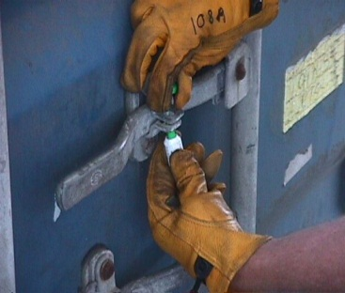
Seal Inspection…
Seal Verification and Inspection Process:
  A seal inspection process should be implemented throughout the supply chain. The V.V.T.T. Seal Inspection Process is a good example of one:
    V – View seal & container locking mechanisms
    V – Verify seal number for accuracy
    T – Tug on seal to make sure it is affixed properly
    T – Twist & Turn seal to make sure it does not unscrew

Slide 2
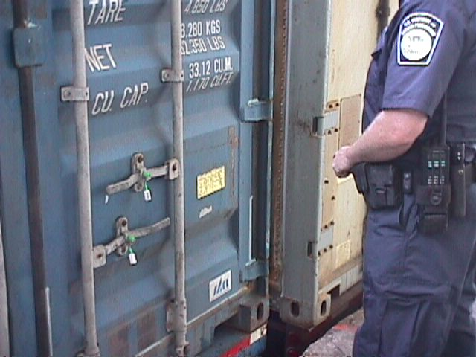
Seal Inspection…
Seal Verification and Inspection Process:
  View seal & container locking mechanisms. Excessive
damage to the seal or locking mechanisms must be
reported to a Supervisor before opening the container.

Slide 3
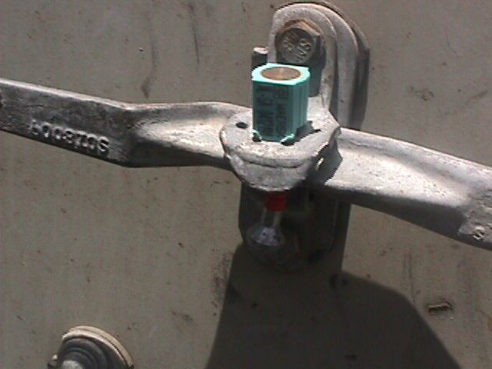
Seal Inspection…
Seal Verification and Inspection Process:
  View seal & container locking mechanisms.
Different brand
One brand
Different brands of seals attached together.

Slide 4
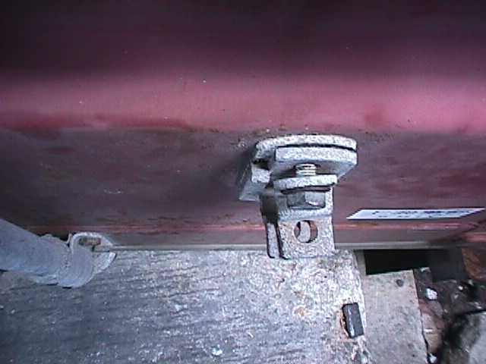
Seal Inspection…
Seal Verification and Inspection Process:
  View seal & container locking mechanisms.
Look for loose bolt and hasp.

Slide 5

Seal Inspection…
Seal Verification and Inspection Process:
  Verify seal number for accuracy. Compare with shipping
documents, and look for alterations to the seal numbers!

Slide 6
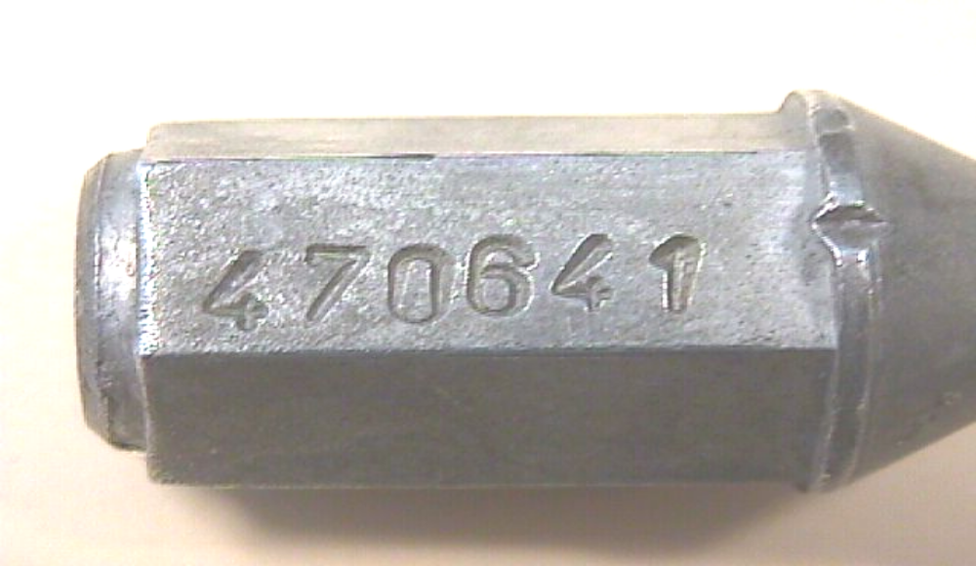
Seal Inspection…
Seal Verification and Inspection Process:
  Verify seal number for accuracy.
Seal number manifested is correct. Wrong seal brand normally used by company.

Slide 7
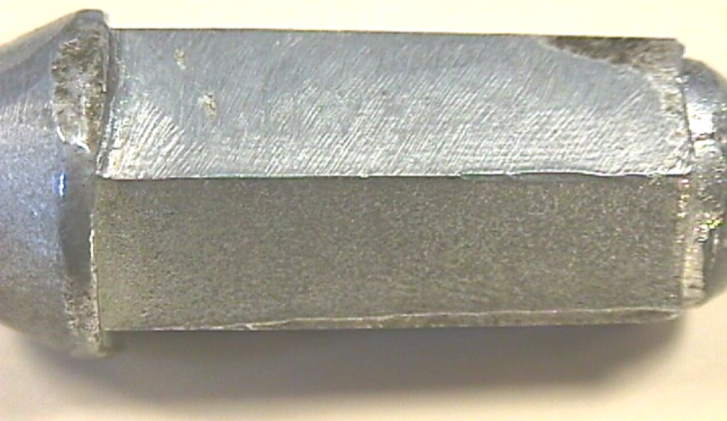
Seal Inspection…
Seal Verification and Inspection Process:
  Verify seal number for accuracy.
Original number sanded off.

Slide 8
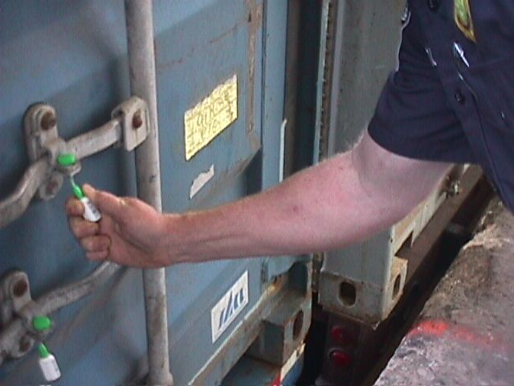
Seal Inspection…
Seal Verification and Inspection Process:
  Tug on seal to make sure it is affixed properly. Human error might cause this to happen, or the container might have contraband inside!

Slide 9
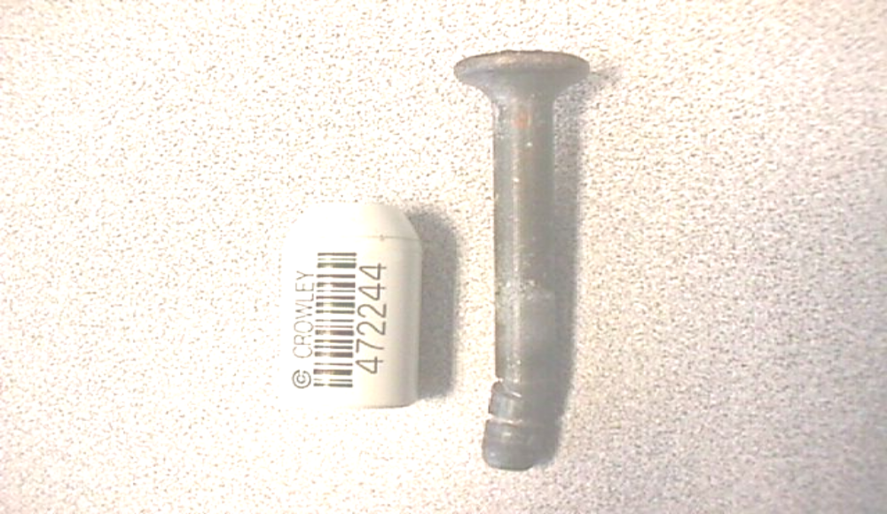
Seal Inspection…
Seal Verification and Inspection Process:
  Tug on seal to make sure it is affixed properly.
Seal stem is bent. Seal does not lock properly.

Slide 10
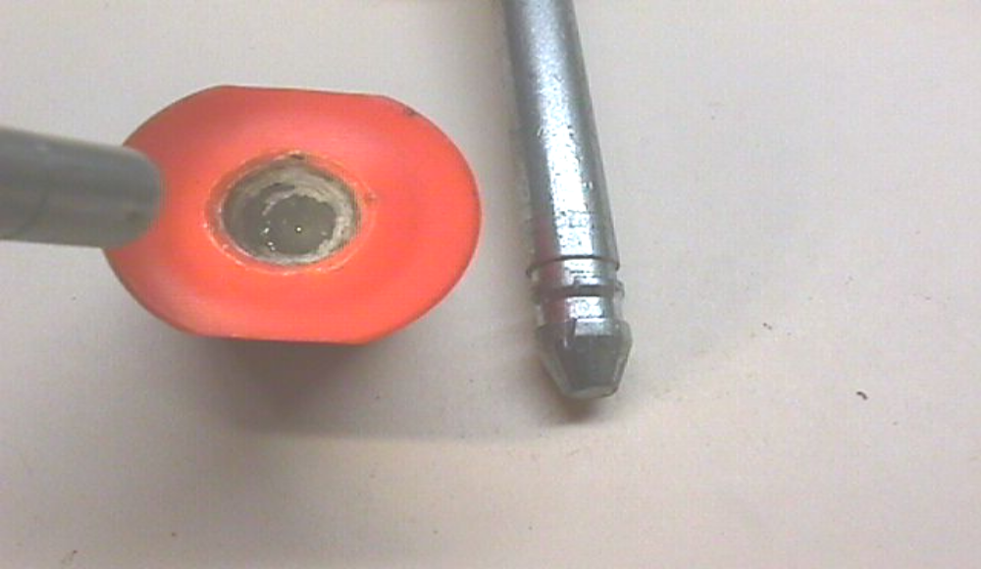
Seal Inspection…
Seal Verification and Inspection Process:
  Tug on seal to make sure it is affixed properly.
Glue inside locking mechanism. Seal does not lock properly.

Slide 11

Seal Inspection…
Seal Verification and Inspection Process:
  Twist & Turn seal to make sure it does not come off. Seals are threaded, so they can be unscrewed. These altered seals are reusable throughout the supply chain for multiple attacks!

Slide 12
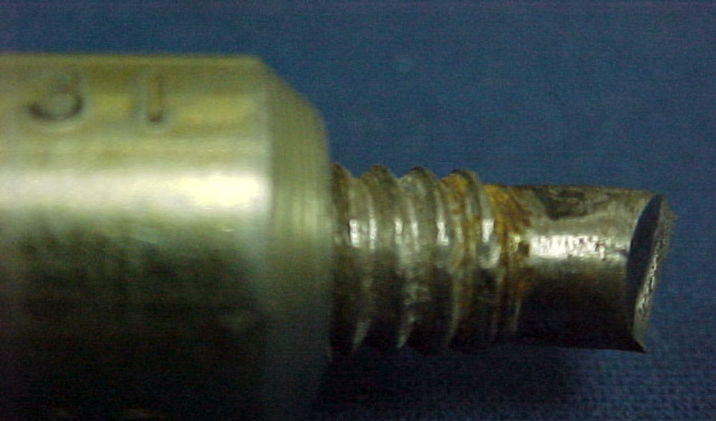
Seal Inspection…
Seal Verification and Inspection Process:
  Twist & Turn seal to make sure it does not unscrew.
Twist counter-clockwise to unscrew.

Slide 13
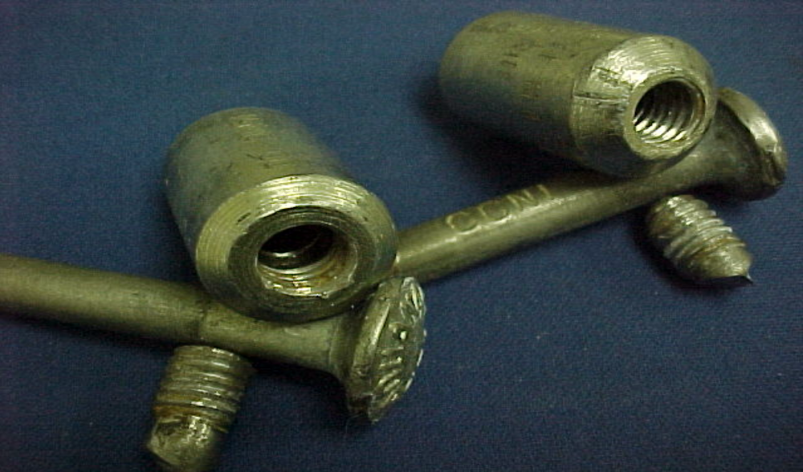
Seal Inspection…
Seal Verification and Inspection Process:
  Twist & Turn seal to make sure it does not unscrew.
Multiple tampered seals.

Slide 14
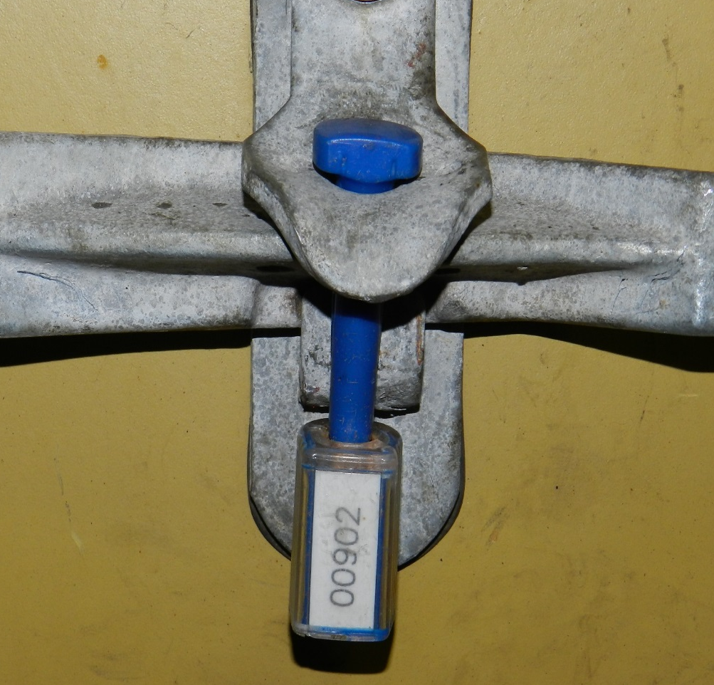
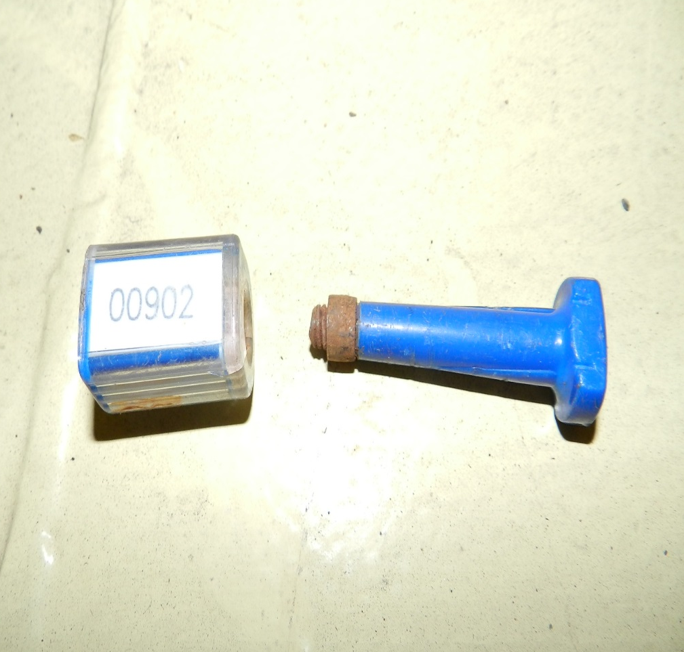
Tampered Seals
  Twist & Turn seal to make sure it does not unscrew
  Seals that are previously cut off from imported shipments can be used to create duplicate seals.
Seal affixed on container
Cut seal mutilated for future use

